Slide 1
TCS 451 Virtualization and Cloud Computing

Slide 2
Unit – I
Introduction to Cloud Computing
Why Cloud Computing (CC)? Different Perspectives on CC, Different Stakeholders in CC, Total cost of ownership (TCO) of on-premises IT, Cloud Computing Taxonomy, Characteristics of cloud computing, Characteristics of cloud computing as per NIST, Cloud Definitions Cloud Computing at a Glance, Vision of Cloud Computing, Cloud Computing Reference Model, Challenges Ahead, Historical Developments, Distributed Systems, Virtualization, Web 2.0, Service-Oriented Computing, Utility-Oriented Computing, Building Cloud Computing Environments, Application Development, Infrastructure and System Development, Computing Platforms and Technologies, Amazon Web Services (AWS), Google AppEngine, Microsoft Azure, Hadoop, Force.com and Salesforce.com

Slide 3
Why Cloud Computing (CC)?
Cloud computing is the delivery of different services through the Internet. These resources include tools and applications like data storage, servers, databases, networking, and software.
Cloud computing is a popular option for people and businesses for a number of reasons including cost savings, increased productivity, speed and efficiency, performance, and security.

Slide 4
Different Perspectives on CC
Cloud computing is named as such because the information being accessed is found remotely in the cloud or a virtual space. Companies that provide cloud services enable users to store files and applications on remote servers and then access all the data via the Internet.
Businesses can employ cloud computing in different ways. Some users maintain all apps and data on the cloud, while others use a hybrid model, keeping certain apps and data on private servers and others on the cloud.
When it comes to providing services, the big players in the corporate computing sphere include:
Google Cloud
Amazon Web Services (AWS)
Microsoft Azure
IBM Cloud
Alibaba Cloud

Slide 5
Different Stakeholders in CC
NIST Cloud Computing reference architecture defines five major performers:
Cloud Provider
Cloud Carrier
Cloud Broker
Cloud Auditor
Cloud Consumer

Slide 6
National Institute of Standards and Technology (NIST)
The National Institute of Standards and Technology (NIST) is a physical sciences laboratory and non-regulatory agency of the United States Department of Commerce.
Its mission is to promote American innovation and industrial competitiveness.
NIST's activities are organized into laboratory programs that include nanoscale science and technology, engineering, information technology, neutron research, material measurement, and physical measurement.
From 1901 to 1988, the agency was named the National Bureau of Standards

Slide 7
Cloud Service Providers
IaaS Providers: In this model, the cloud service providers offer infrastructure components that would exist in an on-premises data center. These components consist of servers, networking, and storage as well as the virtualization layer.
PaaS Providers: In Platform as a Service (PaaS), vendors offer cloud infrastructure and services that can access to perform many functions. In PaaS, services and products are mostly utilized in software development. PaaS providers offer more services than IaaS providers. PaaS providers provide operating system and middleware along with application stack, to the underlying infrastructure.
SaaS Providers: In Software as a Service (SaaS), vendors provide a wide sequence of business technologies, such as Human resources management (HRM) software, customer relationship management (CRM) software, all of which the SaaS vendor hosts and provides services through the internet.

Slide 8
Cloud Carrier
The mediator who provides offers connectivity and transport of cloud services within cloud service providers and cloud consumers.
It allows access to the services of the cloud through Internet networks, telecommunication, and other access devices.
Network and telecom carriers or a transport agent can provide distribution.
A consistent level of services is provided when cloud providers set up Service Level Agreements (SLA) with a cloud carrier. In general, Carrier may be required to offer dedicated and encrypted connections.

Slide 9
Cloud Broker
An organization or a unit that manages the performance, use, and delivery of cloud services by enhancing specific capability and offers value-added services to cloud consumers. It combines and integrates various services into one or more new services. They provide service arbitrage which allows flexibility and opportunistic choices. There are major three services offered by a cloud broker:
Service Intermediation.
Service Aggregation.
Service Arbitrage.

Slide 10
Cloud Auditor
An entity that can conduct independent assessment of cloud services, security, performance, and information system operations of the cloud implementations. The services that are provided by Cloud Service Providers (CSP) can be evaluated by service auditors in terms of privacy impact, security control, and performance, etc. Cloud Auditor can make an assessment of the security controls in the information system to determine the extent to which the controls are implemented correctly, operating as planned and constructing the desired outcome with respect to meeting the security necessities for the system. There are three major roles of Cloud Auditor which are mentioned below:
Security Audit.
Privacy Impact Audit.
Performance Audit.

Slide 11
Cloud Consumer
A cloud consumer is the end-user who browses or utilizes the services provided by Cloud Service Providers (CSP), sets up service contracts with the cloud provider.
The cloud consumer pays peruse of the service provisioned. Measured services utilized by the consumer.
In this, a set of organizations having mutual regulatory constraints performs a security and risk assessment for each use case of Cloud migrations and deployments.

Slide 12
Assignment 1
List of 50 Cloud Service Providers
List of 10 Cloud Carriers
List of 10 Cloud Brokers
List of 10 Cloud Auditors
List of 10 Cloud Consumers
Submission link: https://forms.gle/QEge4junT8wYZ5hQ7

Slide 13
Total cost of ownership (TCO)
The Total Cost of Ownership (TCO) for enterprise software is the sum of all direct and indirect costs incurred by that software, and is a critical part of the ROI calculation.
The total cost of ownership (TCO) is used to calculate the total cost of purchasing and operating a technology product or service over its useful life. The TCO is important for evaluating technology costs that aren't always reflected in upfront pricing.

Slide 14
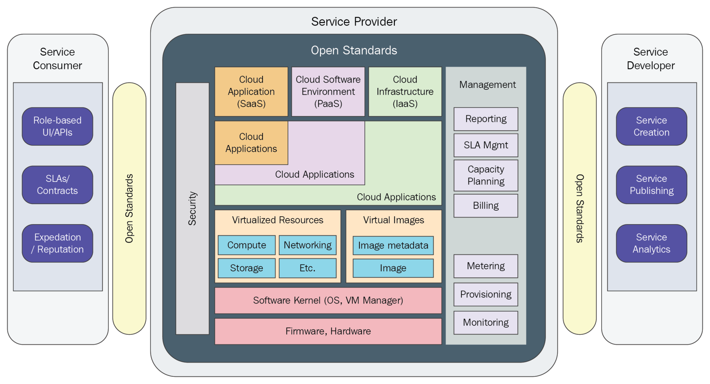
Cloud Computing Taxonomy

Slide 15
Characteristics of cloud computing
On-demand self-services: The Cloud computing services does not require any human administrators, user themselves are able to provision, monitor and manage computing resources as needed.
Broad network access: The Computing services are generally provided over standard networks and heterogeneous devices.
Rapid elasticity: The Computing services should have IT resources that are able to scale out and in quickly and on as needed basis. Whenever the user require services it is provided to him and it is scale out as soon as its requirement gets over.
Resource pooling: The IT resource (e.g., networks, servers, storage, applications, and services) present are shared across multiple applications and occupant in an uncommitted manner. Multiple clients are provided service from a same physical resource.
Measured service: The resource utilization is tracked for each application and occupant, it will provide both the user and the resource provider with an account of what has been used. This is done for various reasons like monitoring billing and effective use of resource

Slide 16
Vision of Cloud Computing
Cloud computing provides the facility to provision virtual hardware, runtime environment and services to a person having money.
These all things can be used as long as they are needed by the user.
The whole collection of computing system is transformed into collection of utilities, which can be provisioned and composed together to deploy systems in hours rather than days, with no maintenance cost.
The long term vision of a cloud computing is that IT services are traded as utilities in an open market without technological and legal barriers.

Slide 17
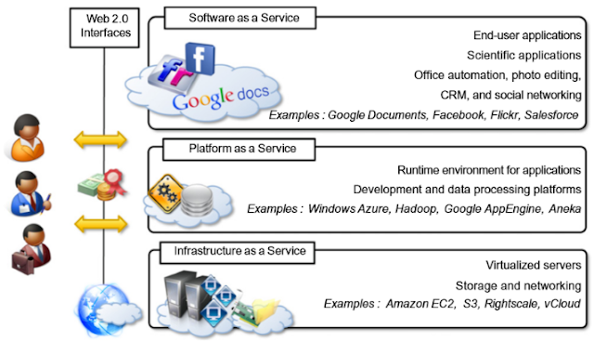
Cloud Computing Reference Model

Slide 18
Cloud Computing Challenges
Security and Privacy: Security and Privacy of information is the biggest challenge to cloud computing. Security and privacy issues can be overcome by employing encryption, security hardware and security applications.
Portability: This is another challenge to cloud computing that applications should easily be migrated from one cloud provider to another. There must not be vendor lock-in. However, it is not yet made possible because each of the cloud provider uses different standard languages for their platforms.
Interoperability: It means the application on one platform should be able to incorporate services from the other platforms. It is made possible via web services, but developing such web services is very complex.
Computing Performance: Data intensive applications on cloud requires high network bandwidth, which results in high cost. Low bandwidth does not meet the desired computing performance of cloud application.
Reliability and Availability: It is necessary for cloud systems to be reliable and robust because most of the businesses are now becoming dependent on services provided by third-party.

Slide 19
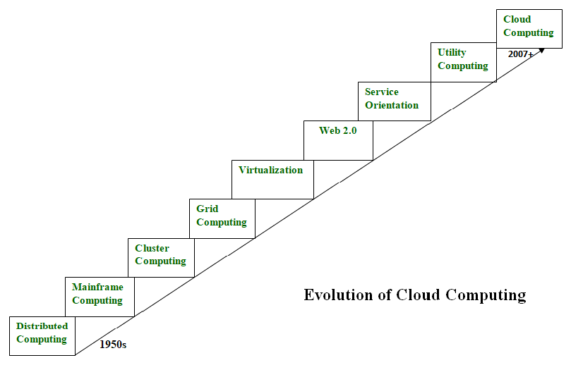
Evolution of Cloud Computing

Slide 20
Distributed Systems
It is a composition of multiple independent systems but all of them are depicted as a single entity to the users.
The purpose of distributed systems is to share resources and also use them effectively and efficiently.
Distributed systems possess characteristics such as scalability, concurrency, continuous availability, heterogeneity, and independence in failures.
But the main problem with this system was that all the systems were required to be present at the same geographical location.
Thus to solve this problem, distributed computing led to three more types of computing and they were-Mainframe computing, cluster computing, and grid computing.

Slide 21
Mainframe computing
Mainframes which first came into existence in 1951 are highly powerful and reliable computing machines.
These are responsible for handling large data such as massive input-output operations.
Even today these are used for bulk processing tasks such as online transactions etc.
These systems have almost no downtime with high fault tolerance. After distributed computing, these increased the processing capabilities of the system.
But these were very expensive. To reduce this cost, cluster computing came as an alternative to mainframe technology.

Slide 22
Cluster computing
In 1980s, cluster computing came as an alternative to mainframe computing.
Each machine in the cluster was connected to each other by a network with high bandwidth.
These were way cheaper than those mainframe systems.
These were equally capable of high computations.
Also, new nodes could easily be added to the cluster if it was required.
Thus, the problem of the cost was solved to some extent but the problem related to geographical restrictions still pertained.
To solve this, the concept of grid computing was introduced.

Slide 23
Grid computing
In 1990s, the concept of grid computing was introduced.
It means that different systems were placed at entirely different geographical locations and these all were connected via the internet.
These systems belonged to different organizations and thus the grid consisted of heterogeneous nodes.
Although it solved some problems but new problems emerged as the distance between the nodes increased.
The main problem which was encountered was the low availability of high bandwidth connectivity and with it other network associated issues.
Thus. cloud computing is often referred to as “Successor of grid computing”.

Slide 24
Virtualization
It was introduced nearly 40 years back.
It refers to the process of creating a virtual layer over the hardware which allows the user to run multiple instances simultaneously on the hardware.
It is a key technology used in cloud computing.
It is the base on which major cloud computing services such as Amazon EC2, VMware vCloud, etc work on.
Hardware virtualization is still one of the most common types of virtualization.

Slide 25
Web 2.0
It is the interface through which the cloud computing services interact with the clients.
It is because of Web 2.0 that we have interactive and dynamic web pages. It also increases flexibility among web pages.
Popular examples of web 2.0 include Google Maps, Facebook, Twitter, etc. Needless to say, social media is possible because of this technology only.
In gained major popularity in 2004.

Slide 26
Service orientation
It acts as a reference model for cloud computing.
It supports low-cost, flexible, and evolvable applications.
Two important concepts were introduced in this computing model.
These were Quality of Service (QoS) which also includes the SLA (Service Level Agreement) and Software as a Service (SaaS).

Slide 27
Utility computing
It is a computing model that defines service provisioning techniques for services such as compute services along with other major services such as storage, infrastructure, etc which are provisioned on a pay-per-use basis.

Slide 28
Cloud Computing Platforms and Technologies
Amazon Web Services (AWS) : AWS provides different wide-ranging clouds IaaS services, which ranges from virtual compute, storage, and networking to complete computing stacks. AWS is well known for its storage and compute on demand services, named as Elastic Compute Cloud (EC2) and Simple Storage Service (S3).
Google AppEngine : Google AppEngine is a scalable runtime environment frequently dedicated to executing web applications. These utilize benefits of the large computing infrastructure of Google to dynamically scale as per the demand. AppEngine offers both a secure execution environment and a collection of which simplifies the development if scalable and high-performance Web applications.

Slide 29
Microsoft Azure: Microsoft Azure is a Cloud operating system and a platform in which user can develop the applications in the cloud. Generally, a scalable runtime environment for web applications and distributed applications is provided. Application in Azure are organized around the fact of roles, which identify a distribution unit for applications and express the application’s logic.
Hadoop : Apache Hadoop is an open source framework that is appropriate for processing large data sets on commodity hardware. Hadoop is an implementation of MapReduce, an application programming model which is developed by Google. This model provides two fundamental operations for data processing: map and reduce.
Force.com and Salesforce.com : Force.com is a Cloud computing platform at which user can develop social enterprise applications. The platform is the basis of SalesForce.com – a Software-as-a-Service solution for customer relationship management. Force.com allows creating applications by composing ready-to-use blocks: a complete set of components supporting all the activities of an enterprise are available.

Slide 30
There are 4 main types of cloud computing: private clouds, public clouds, hybrid clouds, and multiclouds/Community Cloud.
There are also 3 main types of cloud computing services: Infrastructure-as-a-Service (IaaS), Platforms-as-a-Service (PaaS), and Software-as-a-Service (SaaS).

Slide 31
Public clouds are cloud environments typically created from IT infrastructure not owned by the end user. Some of the largest public cloud providers include Alibaba Cloud, Amazon Web Services (AWS), Google Cloud, IBM Cloud, and Microsoft Azure.
Private clouds are loosely defined as cloud environments solely dedicated to a single end user or group, where the environment usually runs behind that user or group's firewall. All clouds become private clouds when the underlying IT infrastructure is dedicated to a single customer with completely isolated access.

Slide 32
A hybrid cloud is a seemingly single IT environment created from multiple environments connected through local area networks (LANs), wide area networks (WANs), virtual private networks (VPNs), and/or APIs.
The characteristics of hybrid clouds are complex and the requirements can differ, depending on whom you ask. For example, a hybrid cloud may need to include:
At least 1 private cloud and at least 1 public cloud
2 or more private clouds
2 or more public clouds
A bare-metal or virtual environment connected to at least 1 public cloud or private cloud

Slide 33
Multiclouds are a cloud approach made up of more than 1 cloud service, from more than 1 cloud vendor—public or private. All hybrid clouds are multiclouds, but not all multiclouds are hybrid clouds. Multiclouds become hybrid clouds when multiple clouds are connected by some form of integration or orchestration.
A community cloud in computing is a collaborative effort in which infrastructure is shared between several organizations from a specific community with common concerns, whether managed internally or by a third-party and hosted internally or externally.

Slide 34
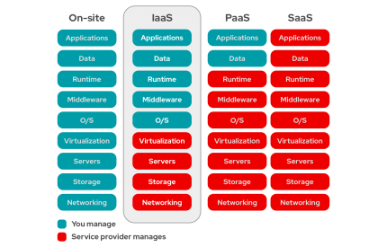

Slide 35
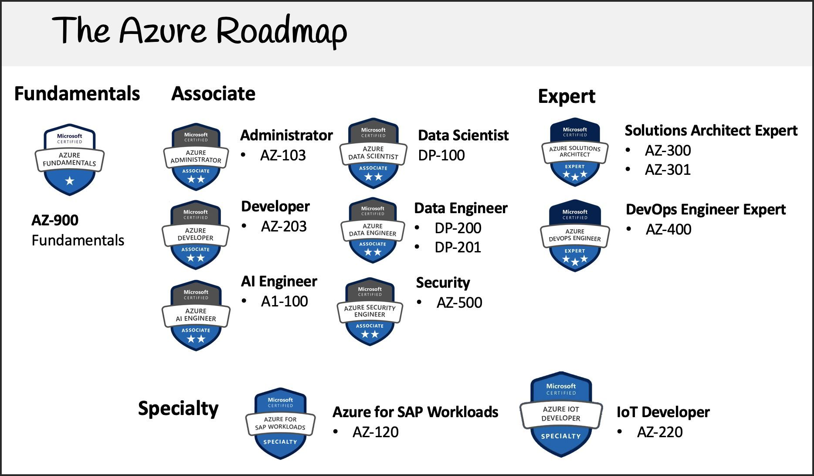

Slide 36
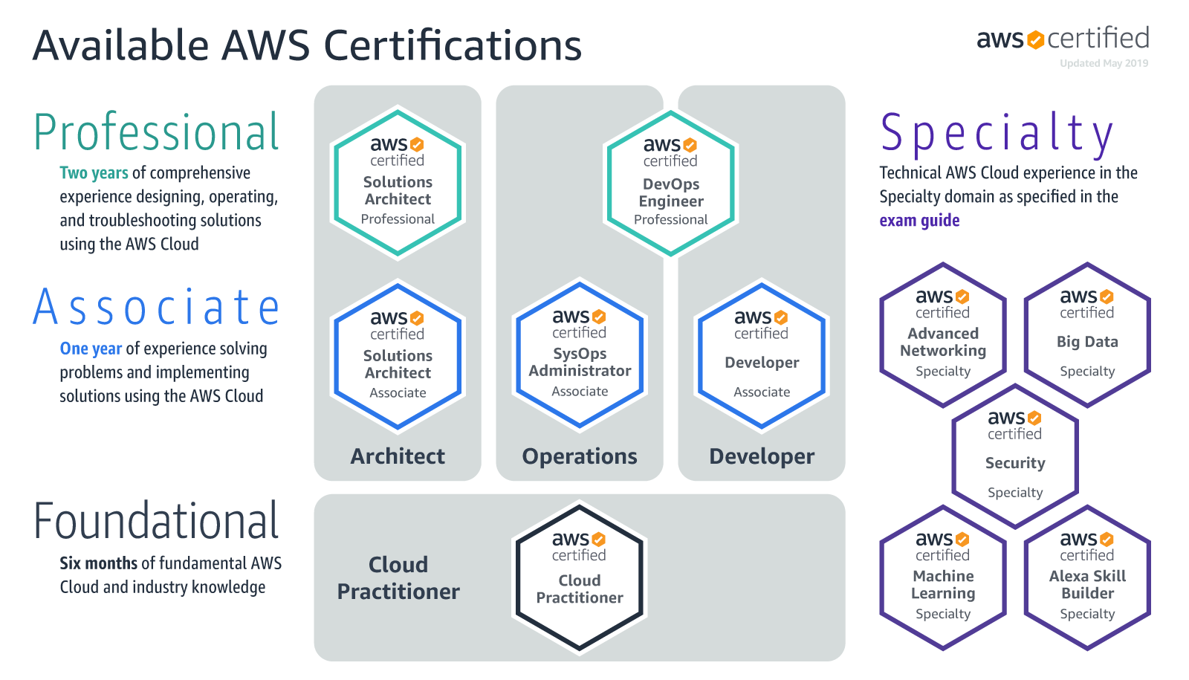

Slide 37
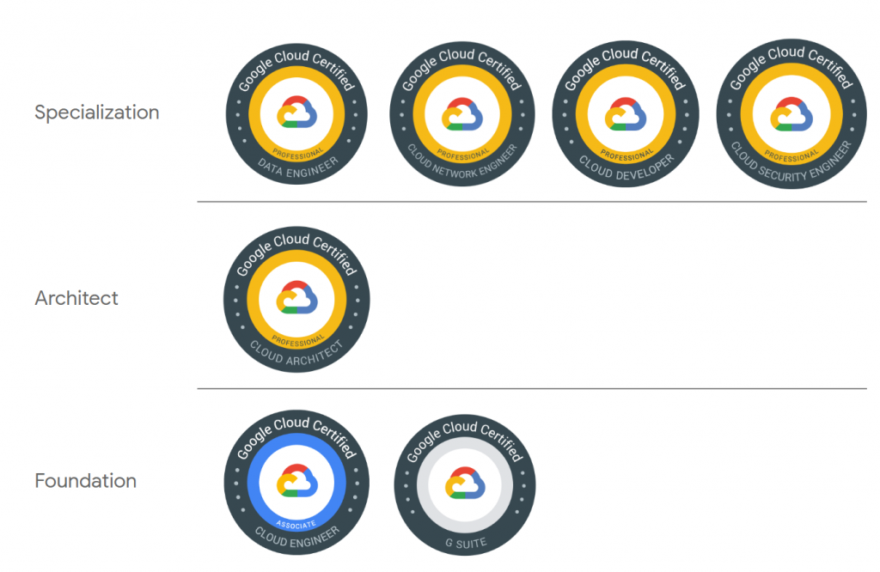

Slide 38
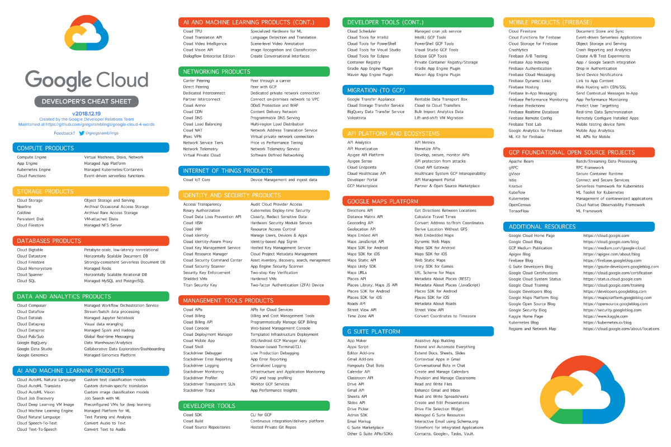

Slide 39
Top-paying certifications:
Google Certified Professional Data Engineer — $171,749
Google Certified Professional Cloud Architect — $169,029
AWS Certified Solutions Architect - Associate — $159,033
CRISC - Certified in Risk and Information Systems Control — $151,995
CISSP - Certified Information Systems Security Professional — $151,853
CISM – Certified Information Security Manager — $149,246
PMP® - Project Management Professional — $148,906
NCP-MCI - Nutanix Certified Professional - Multicloud Infrastructure — $142,810
CISA - Certified Information Systems Auditor — $134,460
VCP-DVC - VMware Certified Professional - Data Center Virtualization 2020 — $132,947
MCSE: Windows Server — $125,980
Microsoft Certified: Azure Administrator Associate — $121,420
CCNP Enterprise - Cisco Certified Network Professional - Enterprise — $118,911
CCA-V - Citrix Certified Associate - Virtualization — $115,308
CompTIA Security+ — $110,974
Source: 15 Highest-Paying IT Certifications in 2021 | Global Knowledge

Slide 40
Assignment 2
Explain Cloud Computing with different Perspectives using suitable case study.
Describe Total cost of ownership (TCO) with suitable case study.
Describe Characteristics of cloud computing as per NIST with suitable examples.
Analyze Cloud Computing Reference Model with suitable diagram.
Briefly explain Distributed Systems, Virtualization, Web 2.0, Service-Oriented Computing, and Utility-Oriented Computing.
Briefly explain Amazon Web Services (AWS), Google AppEngine, Microsoft Azure, Hadoop, Force.com and Salesforce.com.
Submission link: https://forms.gle/QEge4junT8wYZ5hQ7

Slide 41
Presentation
Case study on Distributed Systems,
Case study on Virtualization,
Case study on Web 2.0,
Case study on Service-Oriented Computing,
Case study on Utility-Oriented Computing,
Case study on Amazon Web Services (AWS),
Case study on Google AppEngine,
Case study on Microsoft Azure,
Case study on Hadoop,
Case study on Force.com
Case study on Salesforce.com
Submission link: https://forms.gle/mj8Q82t1XWPTFXyc9

Slide 42
Unit - II
Virtualization Introduction, Characteristics of Virtualized Environments, Taxonomy of Virtualization Techniques, Execution Virtualization, Types of hardware virtualization: Full virtualization - partial virtualization - para virtualization
Desktop virtualization: Software virtualization – Memory virtualization - Storage virtualization – Data Virtualization – Network virtualization, Virtualization and Cloud Computing, Pros and Cons of Virtualization, Technology Examples, Xen: Para virtualization, VMware: Full Virtualization, Microsoft Hyper-V.

Slide 43
Virtualization in Cloud Computing and Types
Virtualization is a technique of how to separate a service from the underlying physical delivery of that service.
It is the process of creating a virtual version of something like computer hardware.
It was initially developed during the mainframe era. It involves using specialized software to create a virtual or software-created version of a computing resource rather than the actual version of the same resource.
With the help of Virtualization, multiple operating systems and applications can run on same machine and its same hardware at the same time, increasing the utilization and flexibility of hardware.

Slide 44
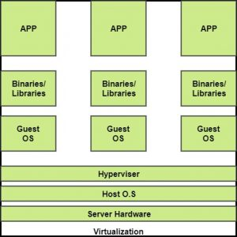

Slide 45
BENEFITS OF VIRTUALIZATION
More flexible and efficient allocation of resources.
Enhance development productivity.
It lowers the cost of IT infrastructure.
Remote access and rapid scalability.
High availability and disaster recovery.
Pay peruse of the IT infrastructure on demand.
Enables running multiple operating systems.

Slide 46
Types of Virtualization
Application Virtualization.
Network Virtualization.
Desktop Virtualization.
Storage Virtualization.
Server Virtualization.
Data virtualization.

Slide 47
Application Virtualization
Application virtualization helps a user to have remote access of an application from a server.
The server stores all personal information and other characteristics of the application but can still run on a local workstation through the internet.
Example of this would be a user who needs to run two different versions of the same software.
Technologies that use application virtualization are hosted applications and packaged applications.

Slide 48
Network Virtualization
The ability to run multiple virtual networks with each has a separate control and data plan.
It co-exists together on top of one physical network.
It can be managed by individual parties that potentially confidential to each other. Network virtualization provides a facility to create and provision virtual networks—logical switches, routers, firewalls, load balancer, Virtual Private Network (VPN), and workload security within days or even in weeks.

Slide 49
Desktop Virtualization
Desktop virtualization allows the users’ OS to be remotely stored on a server in the data centre.
It allows the user to access their desktop virtually, from any location by a different machine.
Users who want specific operating systems other than Windows Server will need to have a virtual desktop.
Main benefits of desktop virtualization are user mobility, portability, easy management of software installation, updates, and patches.

Slide 50
Storage Virtualization
Storage virtualization is an array of servers that are managed by a virtual storage system.
The servers aren’t aware of exactly where their data is stored, and instead function more like worker bees in a hive.
It makes managing storage from multiple sources to be managed and utilized as a single repository.
Storage virtualization software maintains smooth operations, consistent performance and a continuous suite of advanced functions despite changes, break down and differences in the underlying equipment.

Slide 51
Server Virtualization
This is a kind of virtualization in which masking of server resources takes place.
Here, the central-server(physical server) is divided into multiple different virtual servers by changing the identity number, processors.
So, each system can operate its own operating systems in isolate manner.
Where each sub-server knows the identity of the central server.
It causes an increase in the performance and reduces the operating cost by the deployment of main server resources into a sub-server resource.
It’s beneficial in virtual migration, reduce energy consumption, reduce infrastructural cost, etc.

Slide 52
Data virtualization
This is the kind of virtualization in which the data is collected from various sources and managed that at a single place without knowing more about the technical information like how data is collected, stored & formatted then arranged that data logically so that its virtual view can be accessed by its interested people and stakeholders, and users through the various cloud services remotely. Many big giant companies are providing their services like Oracle, IBM, At scale, Cdata, etc.
It can be used to performing various kind of tasks such as:
Data-integration
Business-integration
Service-oriented architecture data-services
Searching organizational data

Slide 53
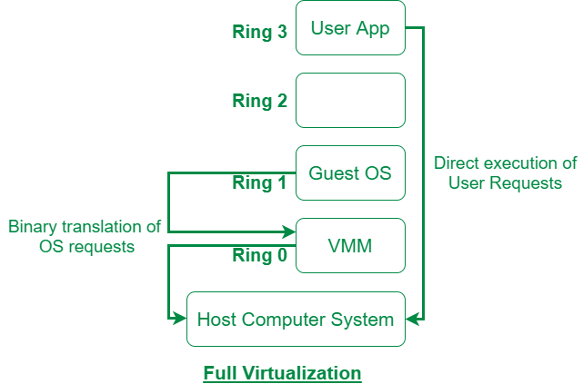
Difference between Full Virtualization and Paravirtualization
Full Virtualization :
Full Virtualization was introduced by IBM in the year 1966. It is the first software solution of server virtualization and uses binary translation and direct approach technique. In full virtualization, guest OS is completely isolated by the virtual machine from the virtualization layer and hardware. Microsoft and Parallels systems are examples of full virtualization.

Slide 54
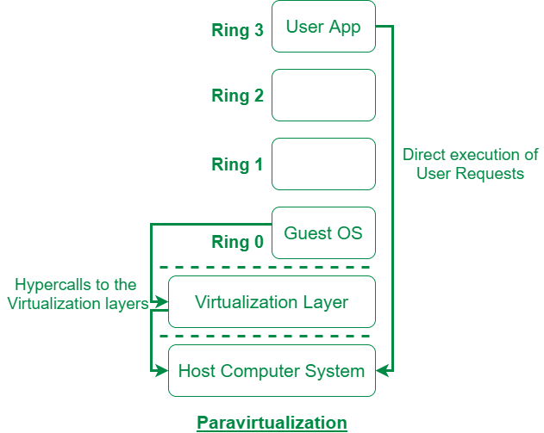
Paravirtualization : Paravirtualization is the category of CPU virtualization which uses hypercalls for operations to handle instructions at compile time. In paravirtualization, guest OS is not completely isolated but it is partially isolated by the virtual machine from the virtualization layer and hardware. VMware and Xen are some examples of paravirtualization.

Slide 55
The difference between Full Virtualization and Paravirtualization are as follows:
Full Virtualization | Paravirtualization
In Full virtualization, virtual machine permit the execution of the instructions with running of unmodified OS in an entire isolated way. | In paravirtualization, virtual machine does not implement full isolation of OS but rather provides a different API which is utilized when OS is subjected to alteration.
Full Virtualization is less secure. | While the Paravirtualization is more secure than the Full Virtualization.
Full Virtualization uses binary translation and direct approach as a technique for operations. | While Paravirtualization uses hypercalls at compile time for operations.
Full Virtualization is slow than paravirtualization in operation. | Paravirtualization is faster in operation as compared to full virtualization.
Full Virtualization is more portable and compatible. | Paravirtualization is less portable and compatible.
Examples of full virtualization are Microsoft and Parallels systems. | Examples of paravirtualization are VMware and Xen.

Slide 56
Partial Virtualization
When entire operating systems cannot run in the virtual machine, but some or many applications can, it is known as Partial Virtualization. Basically, it partially simulates the physical hardware of a system.
This type of virtualization is far easier to execute than full virtualization.

Slide 57
Hypervisor
A hypervisor is a form of virtualization software used in Cloud hosting to divide and allocate the resources on various pieces of hardware.
The program which provides partitioning, isolation or abstraction is called virtualization hypervisor.
The hypervisor is a hardware virtualization technique that allows multiple guest operating systems (OS) to run on a single host system at the same time.
A hypervisor is sometimes also called a virtual machine manager(VMM).

Slide 58
TYPE-1 Hypervisor
The hypervisor runs directly on the underlying host system. It is also known as “Native Hypervisor” or “Bare metal hypervisor”.
It does not require any base server operating system. It has direct access to hardware resources. Examples of Type 1 hypervisors include VMware ESXi, Citrix XenServer and Microsoft Hyper-V hypervisor.

Slide 59
Pros & Cons of Type-1 Hypervisor
Pros: Such kind of hypervisors are very efficient because they have direct access to the physical hardware resources(like Cpu, Memory, Network, Physical storage). This causes the empowerment the security because there is nothing any kind of the third party resource so that attacker couldn’t compromise with anything.
Cons: One problem with Type-1 hypervisor is that they usually need a dedicated separate machine to perform its operation and to instruct different VMs and control the host hardware resources.

Slide 60
TYPE-2 Hypervisor
A Host operating system runs on the underlying host system. It is also known as ‘Hosted Hypervisor”.
Such kind of hypervisors doesn’t run directly over the underlying hardware rather they run as an application in a Host system(physical machine).
Basically, software installed on an operating system. Hypervisor asks the operating system to make hardware calls.
Example of Type 2 hypervisor includes VMware Player or Parallels Desktop. Hosted hypervisors are often found on endpoints like PCs.
The type-2 hypervisor is are very useful for engineers, security analyst(for checking malware, or malicious source code and newly developed applications).

Slide 61
Pros & Cons of Type-2 Hypervisor
Pros: Such kind of hypervisors allows quick and easy access to a guest Operating System alongside the host machine running. These hypervisors usually come with additional useful features for guest machine. Such tools enhance the coordination between the host machine and guest machine.
Cons: Here there is no direct access to the physical hardware resources so the efficiency of these hypervisors lags in performance as compared to the type-1 hypervisors, and potential security risks are also there an attacker can compromise the security weakness if there is access to the host operating system so he can also access the guest operating system.

Slide 62
Pros of Virtualization
Utilization of Hardware Efficiently – With the help of Virtualization Hardware is Efficiently used by user as well as Cloud Service Provider. In this the need of Physical Hardware System for the User is decreases and this results in less costly. In Service Provider point of View, they will vitalize the Hardware using Hardware Virtualization which decrease the Hardware requirement from Vendor side which are provided to User is decreased.
Availability increases with Virtualization – One of the main benefit of Virtualization is that it provides advance features which allow virtual instances to be available all the times. It also has capability to move virtual instance from one virtual Server another Server which is very tedious and risky task in Server Based System. During migration of Data from one server to another it ensures its safety. Also, we can access information from any location and any time from any device.

Slide 63
Disaster Recovery is efficient and easy: With the help of virtualization Data Recovery, Backup, Duplication becomes very easy. In traditional method , if somehow due to some disaster if Server system Damaged then the surety of Data Recovery is very less. But with the tools of Virtualization real time data backup recovery and mirroring become easy task and provide surety of zero percent data loss.
Virtualization saves Energy: Virtualization will help to save Energy because while moving from physical Servers to Virtual Server’s, the number of Server’s decreases due to this monthly power and cooling cost decreases which will Save Money as well. As cooling cost reduces it means carbon production by devices also decreases which results in Fresh and pollution free environment.

Slide 64
Quick and Easy Set up: In traditional methods Setting up physical system and servers are very time-consuming. Firstly Purchase them in bulk after that wait for shipment. When Shipment is done then wait for Setting up and after that again spend time in installing required software etc. Which will consume very time. But with the help of virtualization the entire process is done in very less time which results in productive setup.
Cloud Migration becomes easy: Most of the companies those who already have spent a lot in the server have a doubt of Shifting to Cloud. But it is more cost-effective to shift to cloud services because all the data that is present in their server’s can be easily migrated into the cloud server and save something from maintenance charge, power consumption, cooling cost, cost to Server Maintenance Engineer etc.

Slide 65
Cons of Virtualization
Data can be at Risk: Working on virtual instances on shared resources means that our data is hosted on third party resource which put’s our data in vulnerable condition. Any hacker can attack on our data or try to perform unauthorized access. Without Security solution our data is in threaten situation.
Learning New Infrastructure: As Organization shifted from Servers to Cloud. They required skilled staff who can work with cloud easily. Either they hire new IT staff with relevant skill or provide training on that skill which increase the cost of company.

Slide 66
High Initial Investment: It is true that Virtualization will reduce the cost of companies but also it is truth that Cloud have high initial investment. It provides numerous services which are not required and when unskilled organization will try to set up in cloud they purchase unnecessary services which are not even required to them.

Slide 67
Xen: Para virtualization
Xen is an open source hypervisor based on paravirtualization. It is the most popular application of paravirtualization. Xen has been extended to compatible with full virtualization using hardware-assisted virtualization.
It enables high performance to execute guest operating system.
This is probably done by removing the performance loss while executing the instructions requiring significant handling and by modifying portion of the guest operating system executed by Xen, with reference to the execution of such instructions. Hence this especially support x86, which is the most used architecture on commodity machines and servers.

Slide 68
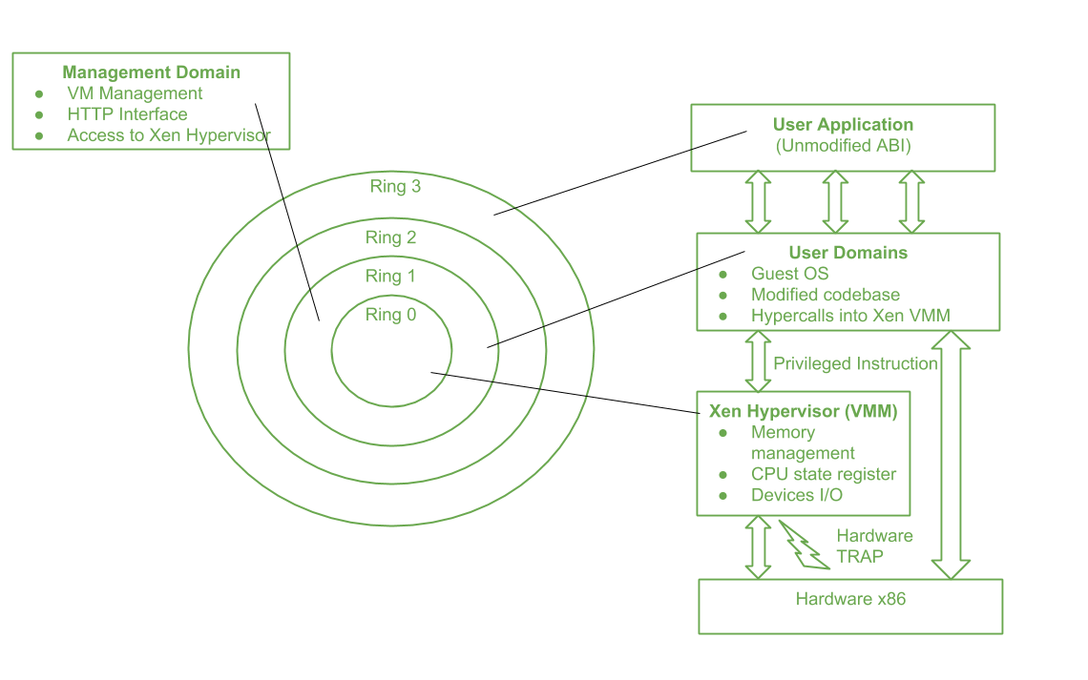

Slide 69
Above figure describes the Xen Architecture and its mapping onto a classic x86 privilege model. A Xen based system is handled by Xen hypervisor, which is executed in the most privileged mode and maintains the access of guest operating system to the basic hardware. Guest operating system are run between domains, which represents virtual machine instances.
In addition, particular control software, which has privileged access to the host and handles all other guest OS, runs in a special domain called Domain 0. This the only one loaded once the virtual machine manager has fully booted, and hosts an HTTP server that delivers requests for virtual machine creation, configuration, and termination. This component establishes the primary version of a shared virtual machine manager (VMM), which is a necessary part of Cloud computing system delivering Infrastructure-as-a-Service (IaaS) solution.

Slide 70
Here, Ring 0 represents the level having most privilege and Ring 3 represents the level having least privilege. Almost all the frequently used Operating system, except for OS/2, uses only two levels i.e. Ring 0 for the Kernel code and Ring 3 for user application and non-privilege OS program. This provides a chance to the Xen to implement paravirtualization. This enables Xen to control unchanged the Application Binary Interface (ABI) thus allowing a simple shift to Xen-virtualized solutions, from an application perspective.
Due to the structure of x86 instruction set, some instructions allow code execution in Ring 3 to switch to Ring 0 (Kernel mode). Such an operation is done at hardware level, and hence between a virtualized environment, it will lead to a TRAP or a silent fault, thus preventing the general operation of the guest OS as it is now running in Ring 1.

Slide 71
Pros:
Xen server is developed over open-source Xen hypervisor and it uses a combination of hardware-based virtualization and paravirtualization. This tightly coupled collaboration between the operating system and virtualized platform enables the system to develop lighter and flexible hypervisor that delivers their functionalities in an optimized manner.
Xen supports balancing of large workload efficiently that capture CPU, Memory, disk input-output and network input-output of data. It offers two modes to handle this workload: Performance enhancement, and For handling data density.
It also comes equipped with a special storage feature that we call Citrix storage link. Which allows a system administrator to uses the features of arrays from Giant companies- Hp, Netapp, Dell Equal logic etc.
It also supports multiple processor, Iive migration one machine to another, physical server to virtual machine or virtual server to virtual machine conversion tools, centralized multiserver management, real time performance monitoring over window and linux.

Slide 72
Cons:
Xen is more reliable over linux rather than on window.
Xen relies on 3rd-party component to manage the resources like drivers, storage, backup, recovery & fault tolerance.
Xen deployment could be a burden some on your Linux kernel system as time passes.
Xen sometimes may cause increase in load on your resources by high input-output rate and and may cause starvation of other Vm’s.

Slide 73
VMware: Full Virtualization
In full virtualization primary hardware is replicated and made available to the guest operating system, which executes unaware of such abstraction and no requirements to modify.
Technology of VMware is based on the key concept of Full Virtualization.
Either in desktop environment, with the help of type-II hypervisor, or in server environment, through type-I hypervisor, VMware implements full virtualization.
In both the cases, full virtualization is possible through the direct execution for non-sensitive instructions and binary translation for sensitive instructions or hardware traps, thus enabling the virtualization of architecture like x86.

Slide 74
Full Virtualization and Binary Translation: VMware is widely used as it tends to virtualize x86 architectures, which executes unmodified on-top of their hypervisors. With the introduction of hardware-assisted virtualization, full virtualization is possible to achieve by support of hardware. But earlier, x86 guest operating systems unmodified in a virtualized environment could be executed only with the use of dynamic binary translation.

Slide 75
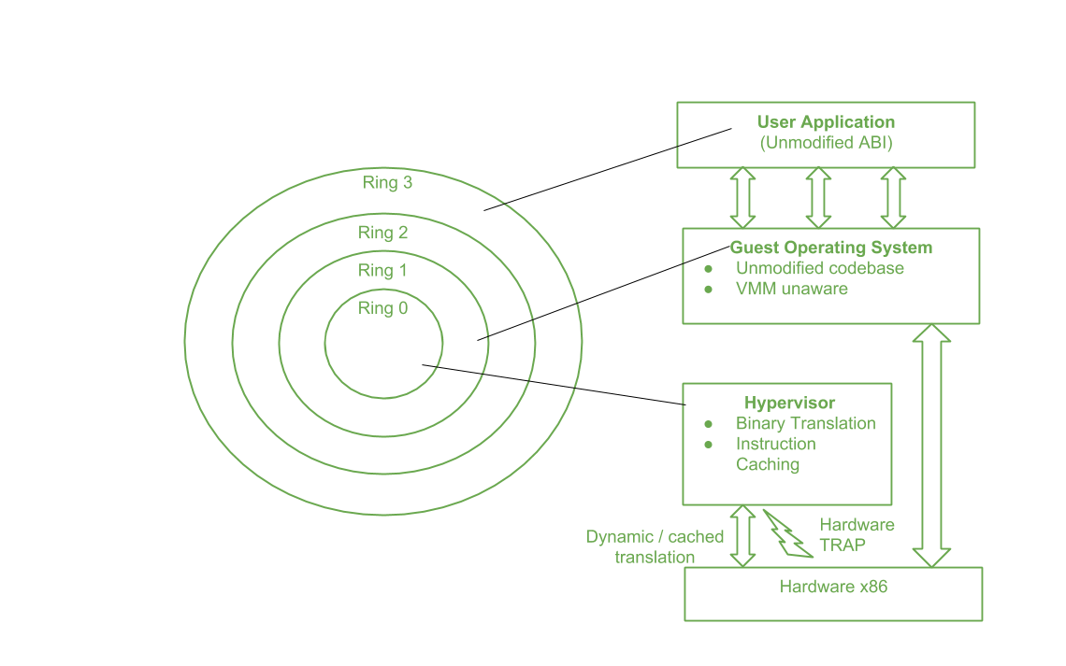

Slide 76
The major benefit of this approach is that guests can run unmodified in a virtualized environment, which is an important feature for operating system whose source code does not existed.
Binary translation is portable for full virtualization.
As well as translation of instructions at runtime presents an additional overhead that is not existed in other methods like paravirtualization or hardware-assisted virtualization.
Contradict, binary translation is only implemented to a subset of the instruction set, while the others are managed through direct execution on the primary hardware.
This depletes somehow the impact on performance of binary translation.

Slide 77
Advantages of Binary Translation –
This kind of virtualization delivers the best isolation and security for Virtual Machine.
Truly isolated numerous guest OS can execute concurrently on the same hardware.
It is only implementation that needs no hardware assist or operating system assist to virtualize sensitive instruction as well as privileged instruction.

Slide 78
Disadvantages of Binary Translation –
It is time consuming at run-time.
It acquires a large performance overhead.
It employs a code cache to stock the translated most used instructions to enhance the performance, but it increases memory utilization along with the hardware cost.
The performance of full virtualization on the x86 architecture is 80 to 95 percent that of the host machine.

Slide 79
Microsoft Hyper-V
Hyper-V is Microsoft's hardware virtualization product. It lets you create and run a software version of a computer, called a virtual machine. Each virtual machine acts like a complete computer, running an operating system and programs. When you need computing resources, virtual machines give you more flexibility, help save time and money, and are a more efficient way to use hardware than just running one operating system on physical hardware.
Hyper-V runs each virtual machine in its own isolated space, which means you can run more than one virtual machine on the same hardware at the same time. You might want to do this to avoid problems such as a crash affecting the other workloads, or to give different people, groups or services access to different systems.

Slide 80
Hyper-V can help you:
Establish or expand a private cloud environment. Provide more flexible, on-demand IT services by moving to or expanding your use of shared resources and adjust utilization as demand changes.
Use your hardware more effectively. Consolidate servers and workloads onto fewer, more powerful physical computers to use less power and physical space.
Improve business continuity. Minimize the impact of both scheduled and unscheduled downtime of your workloads.
Establish or expand a virtual desktop infrastructure (VDI). Use a centralized desktop strategy with VDI can help you increase business agility and data security, as well as simplify regulatory compliance and manage desktop operating systems and applications. Deploy Hyper-V and Remote Desktop Virtualization Host (RD Virtualization Host) on the same server to make personal virtual desktops or virtual desktop pools available to your users.
Make development and test more efficient. Reproduce different computing environments without having to buy or maintain all the hardware you'd need if you only used physical systems.

Slide 81
Hyper-V offers many features. This is an overview, grouped by what the features provide or help you do.
Computing environment - A Hyper-V virtual machine includes the same basic parts as a physical computer, such as memory, processor, storage, and networking. All these parts have features and options that you can configure different ways to meet different needs. Storage and networking can each be considered categories of their own, because of the many ways you can configure them.
Disaster recovery and backup - For disaster recovery, Hyper-V Replica creates copies of virtual machines, intended to be stored in another physical location, so you can restore the virtual machine from the copy. For backup, Hyper-V offers two types. One uses saved states and the other uses Volume Shadow Copy Service (VSS) so you can make application-consistent backups for programs that support VSS.
Optimization - Each supported guest operating system has a customized set of services and drivers, called integration services, that make it easier to use the operating system in a Hyper-V virtual machine.
Portability - Features such as live migration, storage migration, and import/export make it easier to move or distribute a virtual machine.
Remote connectivity - Hyper-V includes Virtual Machine Connection, a remote connection tool for use with both Windows and Linux. Unlike Remote Desktop, this tool gives you console access, so you can see what's happening in the guest even when the operating system isn't booted yet.
Security - Secure boot and shielded virtual machines help protect against malware and other unauthorized access to a virtual machine and its data.

Slide 82
Assignment 3
Describe Characteristics of Virtualized Environments with suitable examples.
Describe Taxonomy of Virtualization Techniques with suitable diagram.
Describe Types of hardware virtualization: Full virtualization - partial virtualization - para virtualization with suitable case study.
Analyze Desktop virtualization, Software virtualization, Memory virtualization, Storage virtualization, Data Virtualization with suitable case study.
Analyze Pros and Cons of Virtualization, Technology with suitable Examples of Xen, Vmware and Microsoft Hyper-V.
Submission link: https://forms.gle/QEge4junT8wYZ5hQ7

Slide 83
Presentation
Case study on Virtualization
Case study on hardware virtualization
Case study on Desktop virtualization
Case study on Storage virtualization
Case study on Network virtualization
Submission link: https://forms.gle/mj8Q82t1XWPTFXyc9

Slide 84
Unit - III
Virtual Machines
Virtual machines basics, Process virtual machines: Memory architecture emulation, Instruction emulation, Operating system emulation, Dynamic binary optimization, High level VN architecture, System virtual machines: Resource virtualization (Processors, Memory, Input/Output), Case Study of Intel VT-x

Slide 85
Virtual machines basics
A virtual machine (VM) is a virtual environment that functions as a virtual computer system with its own CPU, memory, network interface, and storage, created on a physical hardware system (located off- or on-premises). Software called a hypervisor separates the machine’s resources from the hardware and provisions them appropriately so they can be used by the VM.
The physical machines, equipped with a hypervisor such as Kernel-based Virtual Machine (KVM), is called the host machine, host computer, host operating system, or simply host. The many VMs that use its resources are guest machines, guest computers, guest operating systems, or simply guests. The hypervisor treats compute resources—like CPU, memory, and storage—as a pool of resources that can easily be relocated between existing guests or to new virtual machines.
Types of Virtual Machines : Two types

Slide 86
System Virtual Machine
These types of virtual machines gives us complete system platform and gives the execution of the complete virtual operating system. Just like virtual box, system virtual machine is providing an environment for an OS to be installed completely.
We can see in below image that our hardware of Real Machine is being distributed between two simulated operating systems by Virtual machine monitor. And then some programs, processes are going on in that distributed hardware of simulated machines separately.

Slide 87
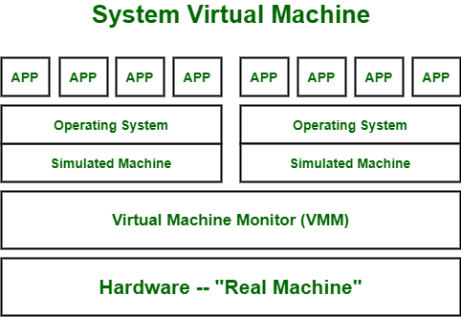

Slide 88
Process virtual machines
While process virtual machines, unlike system virtual machine, does not provide us with the facility to install the virtual operating system completely.
Rather it creates virtual environment of that OS while using some app or program and this environment will be destroyed as soon as we exit from that app.
Like in below image, there are some apps running on main OS as well some virtual machines are created to run other apps.
This shows that as those programs required different OS, process virtual machine provided them with that for the time being those programs are running.

Slide 89
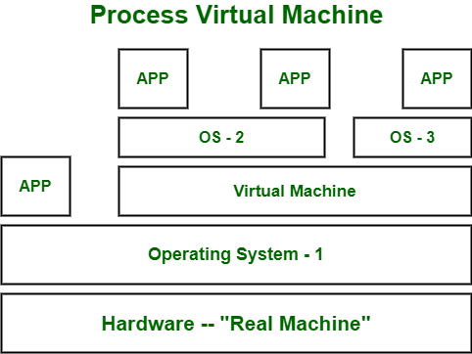

Slide 90
Virtual Machine Language
It’s type of language which can be understood by different operating systems. It is platform-independent.
Just like to run any programming language (C, python, or java) we need specific compiler that actually converts that code into system understandable code (also known as byte code).
The same virtual machine language works.
If we want to use code that can be executed on different types of operating systems like (Windows, Linux, etc) then virtual machine language will be helpful.

Slide 91
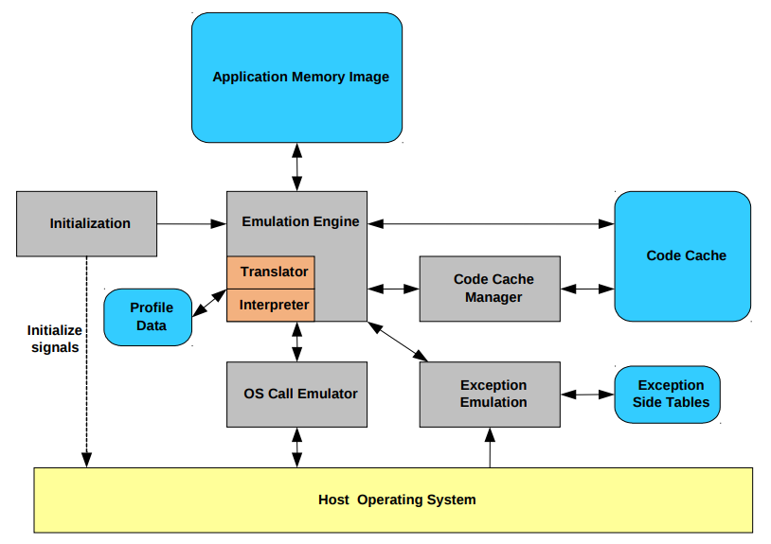

Slide 92
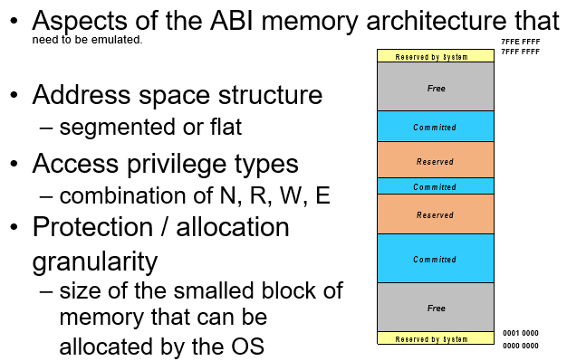
Memory architecture emulation
NONE, READ, WRITE, AND EXECUTE

Slide 93
Instruction emulation
Techniques for instruction emulation
– interpretation, binary translation
Start-up time (S)
– cost of translating code for emulation
– one time cost for translating code
Steady-state performance (T)
– cost of emulation
– average rate at which instructions are emulated

Slide 94
Operating system emulation
• A PVM emulates the function or semantics of the guest’s OS calls
– not emulate individual instructions in the guest OS
• Different from instruction emulation
– given enough time, any function can be performed on the input operands to produce a result
– most ISAs perform same functions, ISA emulation is always possible
– with OS, it is possible that providing some host function is impossible, operation semantic mismatch

Slide 95
Different source and target OS
– semantic translation of mapping required
– may be difficult or impossible
– ad-hoc process on a case-by-case basis
Same source and target OS
– emulate the guest calling convention
– guest system call jumps to runtime, which provides wrapper code

Slide 96
High level VN architecture
Virtual networking enables communication between multiple computers, virtual machines (VMs), virtual servers, or other devices across different office and data center locations. While physical networking connects computers through cabling and other hardware, virtual networking extends these capabilities by using software management to connect computers and servers over the Internet. It uses virtualized versions of traditional network tools, like switches and network adapters, allowing for more efficient routing and easier network configuration changes.
Virtual networking enables devices across many locations to function with the same capabilities as a traditional physical network. This allows for data centers to stretch across different physical locations, and gives network administrators new and more efficient options, like the ability to easily modify the network as needs change, without having to switch out or buy more hardware; greater flexibility in provisioning the network to specific needs and applications; and the capacity to move workloads across the network infrastructure without compromising service, security, and availability.

Slide 97
How does virtual networking work?
A virtual network connects virtual machines and devices, no matter their location, using software. In a physical network, layer 2 and 3 functions of the OSI model happen within physical switches and routers. Plus, physical network interface cards (NIC) and network adapters are used to connect computers and servers to the network. Virtual networking shifts these and other activities to software. A software application, called a virtual switch or vSwitch, controls and directs communication between the existing physical network and virtual parts of the network, like virtual machines. And a virtual network adapter allows computers and VMs to connect to a network, including making it possible for all the machines on a local area network (LAN) to connect to a larger network.
In a physical network, LANs are created to connect multiple devices to shared resources, like network storage, usually through Ethernet cables or Wi-Fi. But virtual networking creates the possibility for virtual LANs (VLANs), where the grouping is configured through software. This means that computers connected to different network switches can behave as if they’re all connected to the same one, and, conversely, computers that share cabling can be kept on separate networks, rather than physically connecting machines using cabling equipment and hardware.

Slide 98
Advantages of virtual networking
Virtual networking delivers a variety of business benefits, from lowering capital expenditures and maintenance costs to easily segmenting networks. Specifically, a virtual network:
Streamlines the amount of network hardware (cabling, switches, etc.) through shifting many functions to software
Reduces the cost and complexity of managing network hardware and software through centralized control
Offers more flexible options for network routing structure and configuration, including easier options for segmenting and subdividing the network
Improves control over network traffic with more fine-grained options, like configuring firewalls at the virtual NIC level
Increases IT productivity through remote and automated service activation and performance testing
Boosts business scalability and flexibility by enabling virtual upgrades, automated configuring, and modular changes to network appliances and applications

Slide 99
Resource virtualization (Processors, Memory, Input/Output)
To support virtualization, processors such as the x86 employ a special running mode and instructions, known as hardware-assisted virtualization.
In this way, the VMM and guest OS run in different modes and all sensitive instructions of the guest OS and its applications are trapped in the VMM.
To save processor states, mode switching is completed by hardware. For the x86 architecture, Intel and AMD have proprietary technologies for hardware-assisted virtualization.

Slide 100
Hardware Support for Virtualization
Modern operating systems and processors permit multiple processes to run simultaneously.
If there is no protection mechanism in a processor, all instructions from different processes will access the hardware directly and cause a system crash.
Therefore, all processors have at least two modes, user mode and supervisor mode, to ensure controlled access of critical hardware. Instructions running in supervisor mode are called privileged instructions.
Other instructions are unprivileged instructions. In a virtualized environment, it is more difficult to make OSes and applications run correctly because there are more layers in the machine stack.

Slide 101
The VMware Workstation is a VM software suite for x86 and x86-64 computers. This software suite allows users to set up multiple x86 and x86-64 virtual computers and to use one or more of these VMs simultaneously with the host operating system. The VMware Workstation assumes the host-based virtualization. Xen is a hypervisor for use in IA-32, x86-64, Itanium, and PowerPC 970 hosts. Actually, Xen modifies Linux as the lowest and most privileged layer, or a hypervisor.
One or more guest OS can run on top of the hypervisor. KVM (Kernel-based Virtual Machine) is a Linux kernel virtualization infrastructure. KVM can support hardware-assisted virtualization and paravirtualization by using the Intel VT-x or AMD-v and VirtIO framework, respectively. The VirtIO framework includes a paravirtual Ethernet card, a disk I/O controller, a balloon device for adjusting guest memory usage, and a VGA graphics interface using VMware drivers.

Slide 102
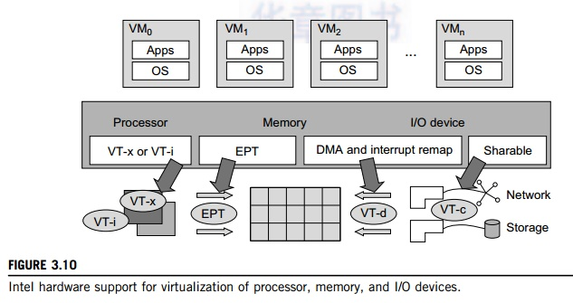
Since software-based virtualization techniques are complicated and incur performance overhead, Intel provides a hardware-assist technique to make virtualization easy and improve performance. Figure 3.10 provides an overview of Intel’s full virtualization techniques. For processor virtualization, Intel offers the VT-x or VT-i technique. VT-x adds a privileged mode (VMX Root Mode) and some instructions to processors. This enhancement traps all sensitive instructions in the VMM automatically. For memory virtualization, Intel offers the EPT, which translates the virtual address to the machine’s physical addresses to improve performance. For I/O virtualization, Intel implements VT-d and VT-c to support this.

Slide 103
CPU Virtualization
A VM is a duplicate of an existing computer system in which a majority of the VM instructions are executed on the host processor in native mode.
Thus, unprivileged instructions of VMs run directly on the host machine for higher efficiency.
Other critical instructions should be handled carefully for correctness and stability.
The critical instructions are divided into three categories: privileged instructions, control-sensitive instructions, and behavior-sensitive instructions.
Privileged instructions execute in a privileged mode and will be trapped if executed outside this mode.
Control-sensitive instructions attempt to change the configuration of resources used.
Behavior-sensitive instructions have different behaviors depending on the configuration of resources, including the load and store operations over the virtual memory.

Slide 104
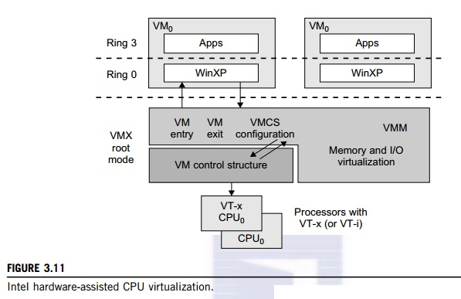
Although x86 processors are not virtualizable primarily, great effort is taken to virtualize them. They are used widely in comparing RISC processors that the bulk of x86-based legacy systems cannot discard easily. Virtualization of x86 processors is detailed in the following sections. Intel’s VT-x technology is an example of hardware-assisted virtualization, as shown in Figure 3.11. Intel calls the privilege level of x86 processors the VMX Root Mode. In order to control the start and stop of a VM and allocate a memory page to maintain the CPU state for VMs, a set of additional instructions is added. At the time of this writing, Xen, VMware, and the Microsoft Virtual PC all implement their hypervisors by using the VT-x technology.

Slide 105
Memory Virtualization
Virtual memory virtualization is similar to the virtual memory support provided by modern operating systems.
In a traditional execution environment, the operating system maintains mappings of virtual memory to machine memory using page tables, which is a one-stage mapping from virtual memory to machine memory.
All modern x86 CPUs include a memory management unit (MMU) and a translation lookaside buffer (TLB) to optimize virtual memory performance.
However, in a virtual execution environment, virtual memory virtualization involves sharing the physical system memory in RAM and dynamically allocating it to the physical memory of the VMs.

Slide 106
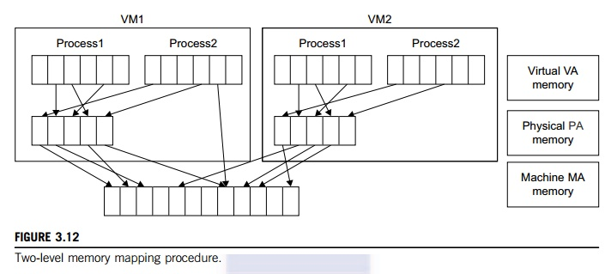
That means a two-stage mapping process should be maintained by the guest OS and the VMM, respectively: virtual memory to physical memory and physical memory to machine memory. Furthermore, MMU virtualization should be supported, which is transparent to the guest OS. The guest OS continues to control the mapping of virtual addresses to the physical memory addresses of VMs. But the guest OS cannot directly access the actual machine memory. The VMM is responsible for mapping the guest physical memory to the actual machine memory. Figure 3.12 shows the two-level memory mapping procedure.

Slide 107
I/O Virtualization
I/O virtualization involves managing the routing of I/O requests between virtual devices and the shared physical hardware.
At the time of this writing, there are three ways to implement I/O virtualization: full device emulation, para-virtualization, and direct I/O.
Full device emulation is the first approach for I/O virtualization. Generally, this approach emulates well-known, real-world devices.

Slide 108
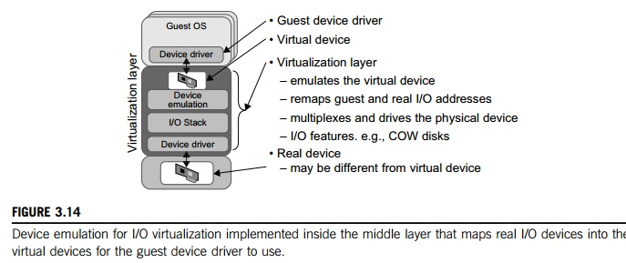
All the functions of a device or bus infrastructure, such as device enumeration, identification, interrupts, and DMA, are replicated in software. This software is located in the VMM and acts as a virtual device. The I/O access requests of the guest OS are trapped in the VMM which interacts with the I/O devices. The full device emulation approach is shown in Figure 3.14.

Slide 109
Assignment 4
Describe Virtual machines basics,
Describe Process virtual machines.
Describe System virtual machines
Submission link: https://forms.gle/QEge4junT8wYZ5hQ7

Slide 110
Presentation
Case study on Process virtual machines
Case study on System virtual machines
Submission link: https://forms.gle/mj8Q82t1XWPTFXyc9

Slide 111
Unit - IV
Parallel and Distributed Computing
Eras of Computing, Parallel vs. Distributed Computing, Elements of Parallel Computing, What is Parallel Processing?, Hardware Architectures for Parallel Processing, Approaches to Parallel Programming, Levels of Parallelism, Laws of Caution, Elements of Distributed Computing, General Concepts and Definitions, Components of a Distributed System, Architectural Styles for Distributed Computing, Models for Inter-Process Communication, Technologies for Distributed Computing, Remote Procedure Call, Distributed Object Frameworks, Service Oriented Computing

Slide 112
Principles of Parallel and Distributed Computing
Cloud computing is a new technological trend that supports better utilization of IT infrastructures, services, and applications.
It adopts a service delivery model based on a pay-per-use approach, in which users do not own infrastructure, platform, or applications but use them for the time they need them.

Slide 113
Eras of computing
The two fundamental and dominant models of computing are sequential and parallel.
The sequential computing era began in the 1940s; the parallel (and distributed) computing era followed it within a decade.

Slide 114
Architectures
Sequential Era
Compilers
Applications
Problem Solving Environments
Architectures
Compilers
Parallel Era
Applications
Problem Solving Environments
1940
1950
1960
1970
1980
1990
2000
2010
2020
2030

Slide 115
Parallel processing
Processing of multiple tasks simultaneously on multiple processors is called parallel processing.
The parallel program consists of multiple active processes (tasks) simultaneously solving a given problem.
A given task is divided into multiple subtasks using a divide-and-conquer technique, and each subtask is processed on a different central processing unit (CPU).
Programming on a multiprocessor system using the divide-and-conquer technique is called parallel programming.

Slide 116
Hardware architectures for parallel processing
Single-instruction, single-data (SISD) systems
Single-instruction, multiple-data (SIMD) systems
Multiple-instruction, single-data (MISD) systems
Multiple-instruction, multiple-data (MIMD) systems

Slide 117

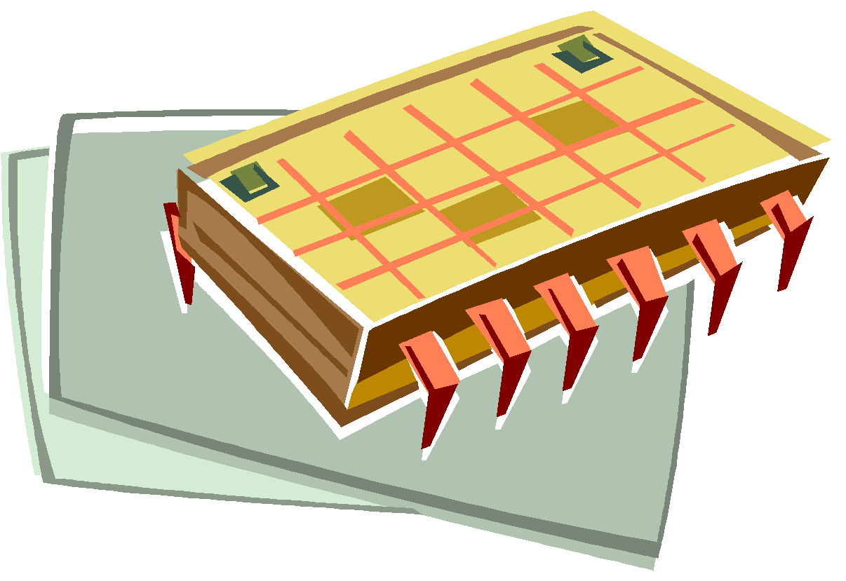
Single-instruction, single-data (SISD) systems
An SISD computing system is a uniprocessor machine capable of executing a single instruction, which operates on a single data stream
Instruction Stream
Data Input
Processor
Data Output

Slide 118
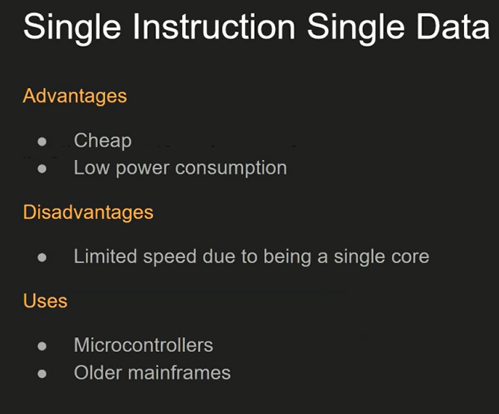

Slide 119
Single-instruction, multiple-data (SIMD) systems
An SIMD computing system is a multiprocessor machine capable of executing the same instruction on all the CPUs but operating on different data streams

Slide 120
Single Instruction Stream
Data Input 1
Processor 1
Data Output 1
Data Input 2
Processor 2
Data Output 2
Data Input N
Processor N
Data Output N

Slide 121
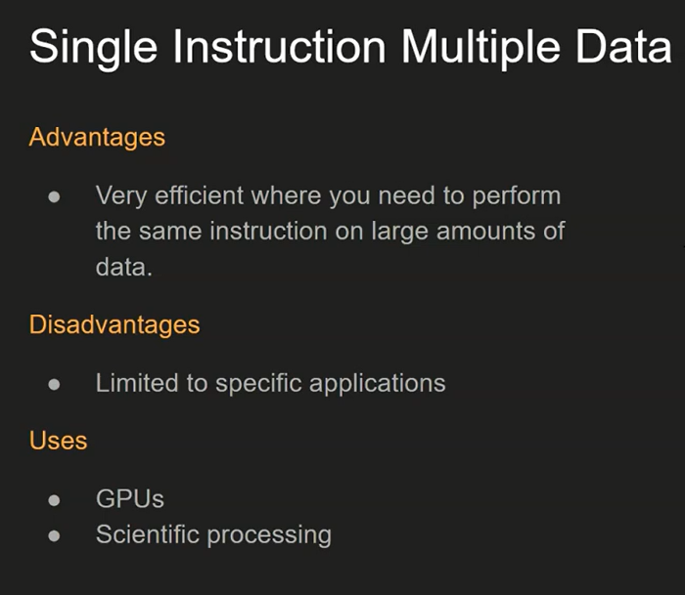

Slide 122
Multiple-instruction, single-data (MISD) systems
An MISD computing system is a multiprocessor machine capable of executing different instructions on different processing elements PEs but all of them operating on the same data set.

Slide 123

Instruction
Stream 1
Instruction
Stream 2
Instruction
Stream N
Processor 1
Processor 2
Single Data Input Stream
Single Data Output Stream
Processor N

Slide 124
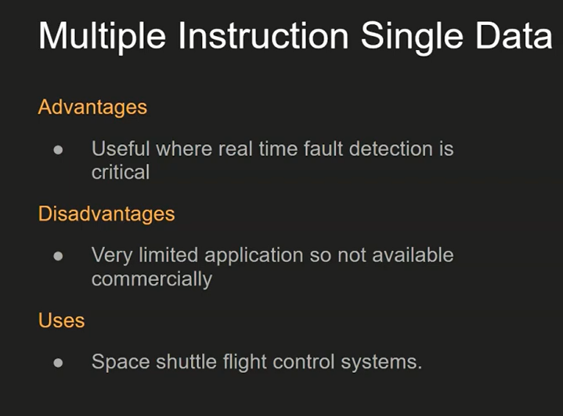

Slide 125
Multiple-instruction, multiple-data (MIMD) systems
An MIMD computing system is a multiprocessor machine capable of executing multiple instructions on multiple data sets.
MIMD machines are broadly categorized into shared-memory MIMD and distributed-memory MIMD based on the way PEs are coupled to the main memory.

Slide 126
Instruction
Stream 1
Instruction
Stream 2
Instruction
Stream N
Data Input 1
Processor 1
Data Output 1
Data Input 2
Processor 2
Data Output 2
Data Input N
Processor N
Data Output 3

Slide 127
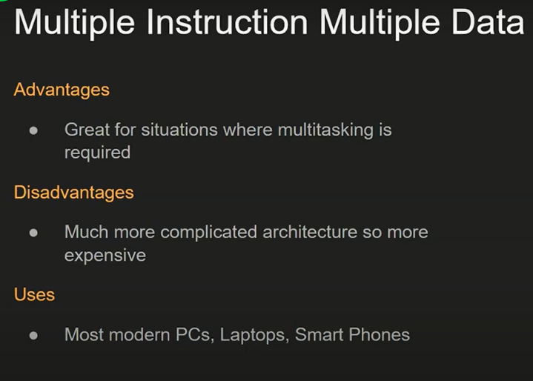

Slide 128
Shared memory MIMD machines
In the shared memory MIMD model, all the PE’s are connected to a single global memory and they all have access to it.
Systems based on this model are also called tightly coupled multiprocessor systems.

Slide 129
Distributed memory MIMD machines
In the distributed memory MIMD model, all PE’s have a local memory.
Systems based on this model are also called loosely coupled multiprocessor systems.

Slide 130

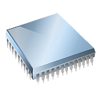
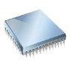
Cache L1
Cache L1
Core 2
IPC Channel
IPC Channel
Processor 1
Processor 2
Processor N
Processor 1
Processor 2
Processor 2
Memory Bus
Memory Bus
Memory Bus
Memory Bus
Global System Memory
Local
Memory
Local
Memory
Local
Memory
Shared (left) and distributed (right) memory MIMD architecture

Slide 131
Approaches to parallel programming
A sequential program is one that runs on a single processor and has a single line of control.
A wide variety of parallel programming approaches are available.
The most prominent among them are the following:
Data parallelism
Process parallelism
Farmer-and-worker model

Slide 132
In the case of data parallelism, the divide-and-conquer technique is used to split data into multiple sets, and each data set is processed on different PEs using the same instruction. This approach is highly suitable to processing on machines based on the SIMD model.
In the case of process parallelism, a given operation has multiple (but distinct) activities that can be processed on multiple processors.
In the case of the farmer- and-worker model, a job distribution approach is used: one processor is configured as master and all other remaining PEs are designated as slaves; the master assigns jobs to slave PEs and, on completion, they inform the master, which in turn collects results.

Slide 133
Levels of parallelism
Levels of parallelism are decided based on the lumps of code (grain size) that can be a potential candidate for parallelism.
Parallelism within an application can be detected at several levels:
Large grain (or task level)
Medium grain (or control level)
Fine grain (data level)
Very fine grain (multiple-instruction issue)

Slide 134

Task 1
Messages IPC
Task 2
Messages IPC
Task N
Large Level
(Processes, Tasks)
Function 1
Shared Memory
Function 2
Shared Memory
Function J
function f1()
{…}
function f2()
{…}
function fJ()
{…}
Medium Level
(Threads, Functions)
Statements
Statements
Statements
Fine Level
(Processor, Instructions)
a[0] = …
b[0] = …
a[1] = …
b[1] = …
a[k] = …
b[k] = …
Very Fine Level
(Cores, Pipeline, Instructions)
+
x
load

Slide 135
Distributed computing
A distributed system is a collection of independent computers that appears to its users as a single coherent system.
A distributed system is one in which components located at networked computers communicate and coordinate their actions only by passing messages.

Slide 136
Components of a distributed system
A distributed system is the result of the interaction of several components that traverse the entire computing stack from hardware to software.
It emerges from the collaboration of several elements that—by working together—give users the illusion of a single coherent system.

Slide 137







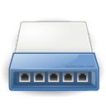


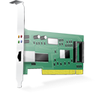
A layered view of a distributed system
Frameworks for distributed programming
Applications
Middleware
IPC primitives for control and data.
Operating System
Networking and Parallel Hardware
Hardware

Slide 138




A cloud computing distributed system
Social Networks, Scientific Computing, Enterprise Applications
Applications (SaaS)
Frameworks for
Cloud Application Development
Middleware (PaaS)
Virtual hardware, networking, OS images, and storage.
Hardware and OS (IaaS)

Slide 139
Architectural styles for distributed computing
Architectural styles are mainly used to determine the vocabulary of components and connectors that are used as instances of the style together with a set of constraints on how they can be combined.
Design patterns help in creating a common knowledge within the community of software engineers and developers as to how to structure the relations of components within an application and understand the internal organization of software applications.
We organize the architectural styles into two major classes:
Software architectural styles
System architectural styles

Slide 140
Component and connectors
A component represents a unit of software that encapsulates a function or a feature of the system. Examples of components can be programs, objects, processes, pipes, and filters.
A connector is a communication mechanism that allows cooperation and coordination among components.

Slide 141
Software architectural styles
Software architectural styles are based on the logical arrangement of software components.
Software Architectural Styles
Data-centered (Repository, Blackboard)
Data flow (Pipe and filter, Batch sequential)
Virtual machine (Rule-based system, Interpreter)
Call and return (Main program and subroutine call/top-down systems, Object-oriented systems, Layered systems)
Independent components (Communicating processes, Event systems)

Slide 142
Data centered architectures
These architectures identify the data as the fundamental element of the software system, and access to shared data is the core characteristic of the data-centered architectures.

Slide 143
Repository architectural style
The repository architectural style is the most relevant reference model in this category.
It is characterized by two main components: the central data structure, which represents the current state of the system, and a collection of independent components, which operate on the central data.
The ways in which the independent components interact with the central data structure can be very heterogeneous.

Slide 144
Blackboard architectural style
In blackboard systems, the central data structure is the main trigger for selecting the processes to execute.
The blackboard architectural style is characterized by three main components:
Knowledge sources: These are the entities that update the knowledge base that is maintained in the blackboard.
Blackboard: This represents the data structure that is shared among the knowledge sources and stores the knowledge base of the application.
Control: The control is the collection of triggers and procedures that govern the interaction with the blackboard and update the status of the knowledge base.

Slide 145
Data-flow architectures
Data-flow architectures, it is the availability of data that controls the computation.

Slide 146
Batch Sequential Style
The batch sequential style is characterized by an ordered sequence of separate programs executing one after the other.
These programs are chained together by providing as input for the next program the output generated by the last program after its completion, which is most likely in the form of a file.
This design was very popular in the mainframe era of computing and still finds applications today

Slide 147
Pipe-and-Filter Style
The pipe-and-filter style is a variation of the previous style for expressing the activity of as of software system as sequence of data transformations.
Each component of the processing chain is called a filter, and the connection between one filter and the next is represented by a data stream.
Data-flow architectures are optimal when the system to be designed embodies a multistage process, which can be clearly identified into a collection of separate components that need to be orchestrated together.

Slide 148
Virtual machine architectures
The virtual machine class of architectural styles is characterized by the presence of an abstract execution environment (generally referred as a virtual machine) that simulates features that are not available in the hardware or software.

Slide 149
Rule-Based Style
This architecture is characterized by representing the abstract execution environment as an inference engine.
Programs are expressed in the form of rules or predicates that hold true.
The input data for applications is generally represented by a set of assertions or facts that the inference engine uses to activate rules or to apply predicates, thus transforming data. The output can either be the product of the rule activation or a set of assertions that holds true for the given input data.
Rule-based systems are very popular in the field of artificial intelligence.

Slide 150
Interpreter Style
The core feature of the interpreter style is the presence of an engine that is used to interpret a pseudo-program expressed in a format acceptable for the interpreter.
The interpretation of the pseudo-program constitutes the execution of the program itself.

Slide 151
Call & return architectures
This category identifies all systems that are organised into components mostly connected together by method calls.
The activity of systems modeled in this way is characterized by a chain of method calls whose overall execution and composition identify the execution of one or more operations

Slide 152
Top-Down Style
This architectural style is quite representative of systems developed with imperative programming, which leads to a divide-and-conquer approach to problem resolution.
Systems developed according to this style are composed of one large main program that accomplishes its tasks by invoking subprograms or procedures

Slide 153
Object-Oriented Style
This architectural style encompasses a wide range of systems that have been designed and implemented by leveraging the abstractions of object-oriented programming (OOP).
Systems are specified in terms of classes and implemented in terms of objects.

Slide 154
Layered Style
The layered system style allows the design and implementation of software systems in terms of layers, which provide a different level of abstraction of the system.
Each layer generally operates with at most two layers: the one that provides a lower abstraction level and the one that provides a higher abstraction layer.

Slide 155
Architectural styles based on independent components
This class of architectural style models systems in terms of independent components that have their own life cycles, which interact with each other to perform their activities.
There are two major categories within this class communicating processes and event systems which differentiate in the way the interaction among components is managed.
Notes:
03/19/2017 Section C

Slide 156
Communicating Processes: In this architectural style, components are represented by independent processes that leverage IPC facilities for coordination management.
Event Systems: In this architectural style, the components of the system are loosely coupled and connected.

Slide 157
System architectural styles
System architectural styles cover the physical organization of components and processes over a distributed infrastructure.
There are two fundamental reference styles: client/server and peer-to-peer.

Slide 158
Client/server
This architecture is very popular in distributed computing and is suitable for a wide variety of applications.
The client/server model features two major components: a server and a client.
These two components interact with each other through a network connection using a given protocol.
The important operations in the client-server paradigm are request, accept (client side),and listen and response (server side).
Notes:
21/03/2018 CC

Slide 159








Client/server architectural styles
request
Two Tier
(Classic Model)
client
response
server
Three Tier
client
Server/client
server
N Tier
server
client
Server/client
Server/client
server

Slide 160
Two-tier architecture
This architecture partitions the systems into two tiers, which are located one in the client component and the other on the server.
The client is responsible for the presentation tier by providing a user interface; the server concentrates the application logic and the data store into a single tier.

Slide 161
Three-tier architecture/N-tier architecture
The three-tier architecture separates the presentation of data, the application logic, and the data storage into three tiers.
This architecture is generalized into an N-tier model in case it is necessary to further divide the stages composing the application logic and storage tiers.
This model is generally more scalable than the two-tier one because it is possible to distribute the tiers into several computing nodes, thus isolating the performance bottle necks.

Slide 162
Peer-to-peer
The peer-to-peer model, introduces asymmetric architecture in which all the components , called peers, play the same role and incorporate both client and server capabilities of the client/server model.
More precisely, each peer acts as a server when it processes requests from other peers and as a client when it issues requests to other peers.
This model is quite suitable for highly decentralized architecture, which can scale better along the dimension of the number of peers.
The disadvantage of this approach is that the management of the implementation of algorithms is more complex than in the client/server model.

Slide 163


Peer-to-peer architectural style
peer
peer
peer
peer
peer
peer
peer

Slide 164
Models for inter process communication
Distributed systems are composed of a collection of concurrent processes interacting with each other by means of a network connection.
Therefore, IPC is a fundamental aspect of distributed systems design and implementation.
IPC is used to either exchange data and information or coordinate the activity of processes.

Slide 165
Message-based communication
Message passing: This paradigm introduces the concept of a message as the main abstraction of the model. The entities exchanging information explicitly encode in the form of a message the data to be exchanged. Examples of this model are the Message-Passing Interface(MPI) and Open MP.
Remote procedure call (RPC): This paradigm extends the concept of procedure call beyond the boundaries of a single process, thus triggering the execution of code in remote processes.
Distributed objects: This is an implementation of the RPC model for the object-oriented paradigm and contextualizes this feature for the remote invocation of methods exposed by objects. Each process registers a set of interfaces that are accessible remotely. Examples of distributed object infrastructures are Common Object Request Broker Architecture(CORBA), Component Object Model (COM, DCOM, and COM1), Java Remote Method Invocation(RMI), and .NET Remoting

Slide 166
Distributed agents and active objects: Programming paradigms based on agents and active objects involve by definition the presence of instances, whether they are agents of objects, despite the existence of requests.
Web services: Web service technology provides an implementation of the RPC concept over HTTP, thus allowing the interaction of components that are developed with different technologies.

Slide 167
Models for message-based communication
Point-to-point message model : This model organizes the communication among single components. Each message is sent from one component to another, and there is a direct addressing to identify the message receiver.
Publish-and-subscribe message model : This model introduces a different strategy, one that is based on notification among components. There are two major roles: the publisher and the subscriber. The publish-and-subscribe model is very suitable for implementing systems based on the one- to-many communication model and simplifies the implementation of indirect communication pat- terns.
Notes:
cc

Slide 168
Request-reply message model : The request-reply message model identifies all communication models in which, for each message sent by a process, there is a reply. Publish- and-subscribe models are less likely to be based on request-reply since they rely on notifications.

Slide 169
Technologies for distributed computing
Remote procedure call (RPC),
Distributed object frameworks,
Service-oriented computing.

Slide 170
Remote procedure call
RPC is the fundamental abstraction enabling the execution of procedures on client’s request.
RPC allows extending the concept of a procedure call beyond the boundaries of a process and a single memory address space.
The called procedure and calling procedure may be on the same system or they may be on different systems in a network.
An important aspect of RPC is marshaling, which identifies the process of converting parameter and return values into a form that is more suitable to be transported over a network through a sequence of bytes. The term unmarshaling refers to the opposite procedure.

Slide 171
Developing a system leveraging RPC for IPC consists of the following steps:
Design and implementation of the server procedures that will be exposed for remote invocation.
Registration of remote procedures with the RPC server on the node where they will be made available.
Design and implementation of the client code that invokes the remote procedure(s).

Slide 172
The RPC reference model
Node A
Node B
Main Procedure
RPC Service
Procedure Registry
Procedure A
Procedure C:Node B
Procedure C
Procedure B
RPC Library
Program A (RPC Client)
Program C (RPC Server)
Parameters Marshaling and Procedure Name
Return Value
Unmarshaling
Parameters Unmarshaling and Procedure Name
Return Value
Marshaling
Network

Slide 173
Distributed object frameworks
Distributed object frameworks extend object-oriented programming systems by allowing objects to be distributed across a heterogeneous network and provide facilities so that they can coherently act as though they were in the same address space.
Distributed object frameworks give the illusion of interaction with a local instance while invoking remote methods. This is done by a mechanism called a proxy skeleton.

Slide 174
The common interaction pattern is the following:
1.The server process maintains a registry of active objects that are made available to other processes. According to the specific implementation, active objects can be published using interface definitions or class definitions.
2.The client process, by using a given addressing scheme, obtains a reference to the active remote object. This reference is represented by a pointer to an instance that is of a shared type of interface and class definition.
3.The client process invokes the methods on the active object by calling them through the reference previously obtained. Parameters and return values are marshaled as happens in the case of RPC.
Notes:
23/03/2018 cc

Slide 175
The distributed object programming model
Node A
Node B
Application B
Instance
Remote
Instance
21
10
16
15
1: Ask for Reference
Object Proxy
Object Skeleton
5: Object Activation
9
11
20
17
14
6
4
Remote Reference Module
Remote Reference Module
Application A
8
12
13
7
2
19
18
3
Network

Slide 176
Examples of distributed object frameworks
Common object request broker architecture(CORBA): CORBA is a specification introduced by the Object Management Group(OMG) for providing cross- platform and cross-l.
Distributed component object model (DCOM/COM1): DCOM, later integrated and evolved into COM1, is the solution provided by Microsoft for distributed object programming before the introduction of .NET technology. DCOM introduces a set of features allowing the use of COM components beyond the process boundaries.
Notes:
21/03/18 CS C

Slide 177
Java remote method invocation (RMI): Java RMI is a standard technology provided by Java for enabling RPC among distributed Java objects. RMI defines an infrastructure allowing the invocation of methods on objects that are located on different Java Virtual Machines (JVMs) residing either on the local node or on a remote one.
.NET remoting : Remoting is the technology allowing for IPC among .NET applications. It provides developers with a uniform platform for accessing remote objects from within any application developed in any of the languages supported by.NET.

Slide 178
Service-oriented computing
Service-oriented computing organizes distributed systems in terms of services, which represent the major abstraction for building systems.
Service orientation expresses applications and software systems as aggregations of services that are coordinated within a service-oriented architecture(SOA).

Slide 179
Boundaries are explicit. A service-oriented application is generally composed of services that are spread across different domains, trust authorities, and execution environments.
Services are autonomous. Services are components that exist to offer functionality and are aggregated and coordinated to build more complex system. They are not designed to be part of a specific system, but they can be integrated in several software systems, even at the same time

Slide 180
Services share schema and contracts, not class or interface definitions. Services are not expressed in terms of classes or interfaces, as happens in object-oriented systems, but they define them selves in terms of schemas and contracts.
Services compatibility is determined based on policy.
Service orientation separates structural compatibility from semantic compatibility.
Structural compatibility is based on contracts and schema and can be validated or enforced by machine-based techniques.

Slide 181
Service-oriented architecture (SOA)
SOA is an architectural style supporting service orientation.
It organizes a software system into a collection of interacting services.
SOA encompasses a set of design principles that structure system development and provide means for integrating components in to a coherent and decentralized system.

Slide 182
Features
Standardized service contract: Services adhere to a given communication agreement, which is specified through one or more service description documents.
Loose coupling: Services are designed as self-contained components, maintain relationships that minimize dependencies on other services, and only require being aware of each other.
Abstraction: A service is completely defined by service contracts and description documents. They hide their logic, which is encapsulated within their implementation.

Slide 183
Reusability: Designed as components, services can be reused more effectively, thus reducing development time and the associated costs. Reusability allows for a more agile design and cost-effective system implementation and deployment
Autonomy: Services have control over the logic they encapsulate and, from a service consumer point of view, there is no need to know about their implementation
Lack of state: By providing a state less interaction pattern (at least in principle), services increase the chance of being reused and aggregated, especially in a scenario in which a single service is used by multiple consumers that belong to different administrative and business domains.

Slide 184
Discoverability: Services are defined by description documents that constitute supplemental metadata through which they can be effectively discovered. Service discovery provides an effective means for utilizing third-party resources.
Composability: Using services as building blocks, sophisticated and complex operations can be implemented. Service orchestration and choreography provide a solid support for composing services and achieving business goals.

Slide 185
Web services
Web services are the prominent technology for implementing SOA systems and applications. They leverage Internet technologies and standards for building distributed systems.
The concept behind a Web service is very simple.
Using as a basis the object-oriented abstraction, a Web service exposes a set of operations that can be invoked by leveraging Internet-based protocols.
System architects develop a Web service with their technology of choice and deploy it in compatible Web or application servers.

Slide 186
WS technology Stack
WSFL
Web Service Flow
Static 🡪 UDDI
Service Discovery
Direct 🡪 UDDI
Service Publication
Security
Management
Quality of Service
WSDL
Service Description
SOAP
XML-based Messaging
HTTP, FTP,e-mail, MQ, IIOP, ….
Network

Slide 187
Simple Object Access Protocol (SOAP), an XML-based language for exchanging structured information in a platform-independent manner, constitutes the protocol used for Web service method invocation.

Slide 188
SOAP Messages
POST /InStock HTTP/1.1
Host: www.stocks.com
Content-Type: application/soap+xml; charset=utf-8
Content-Length: <Size>
<?xml version=“1.0”>
<soap:Envelope xmlns:soap=“http//www.w3.org/2001/12/soap-envelope”
soap:encondingStyle=“http//www.w3.org/2001/12/soap-encoding”>
<soap:Header></soap:Header>
<soap:Body xmlns:m=http://www.stocks.org/stock>
<m:GetStockPrice>
<m:StockName>IBM<m:StockName>
</m:GetStockPrice>
</soap:Body>
</soap:Envelope>
Envelope
Header: Metadata & Assertions
Body: Method Call

Slide 189
SOAP Messages
POST /InStock HTTP/1.1
Host: www.stocks.com
Content-Type: application/soap+xml; charset=utf-8
Content-Length: <Size>
<?xml version=“1.0”>
<soap:Envelope xmlns:soap=“http//www.w3.org/2001/12/soap-envelope”
soap:encondingStyle=“http//www.w3.org/2001/12/soap-encoding”>
<soap:Header></soap:Header>
<soap:Body xmlns:m=http://www.stocks.org/stock>
<m:GetStockPriceResponse>
<m:Price>34.5<m:Price>
</m:GetStockPriceResponse>
</soap:Body>
</soap:Envelope>
Envelope
Header: Metadata & Assertions
Body: Execution Result

Slide 190
Service orientation and cloud computing
Web services and Web 2.0-related technologies constitute a fundamental building block for cloud computing systems and applications.
Web 2.0 applications are the front end of cloud computing systems, which deliver services either via Web service or provide a profitable interaction with AJAX-based clients.

Slide 191
Assignment 5
Describe Parallel vs. Distributed Computing,
Describe Elements of Parallel Computing
Describe Hardware Architectures for Parallel Processing
Describe Approaches to Parallel Programming,
Describe Levels of Parallelism,
Describe Laws of Caution,
Describe Elements of Distributed Computing,
Describe Architectural Styles for Distributed Computing,
Describe Models for Inter-Process Communication,
Describe Technologies for Distributed Computing,
Describe Remote Procedure Call,
Describe Distributed Object Frameworks,
Describe Service Oriented Computing
Submission link: https://forms.gle/QEge4junT8wYZ5hQ7

Slide 192
Presentation
Case study on Parallel vs. Distributed Computing
Submission link: https://forms.gle/mj8Q82t1XWPTFXyc9

Slide 193
Unit - V
Cloud Computing Architecture
Fundamental Cloud Architectures - Workload Distribution Architecture - Resource Pooling Architecture - Dynamic Scalability Architecture – Elastic Resource Capacity Architecture -Service Load Balancing Architecture – Cloud Bursting Architecture - Elastic Disk Provisioning Architecture – Redundant Storage Architecture. Cloud Computing Reference Architecture (CCRA):
Introduction, benefits of CCRA, Migrating into a Cloud: Introduction, Challenges while migrating to Cloud, Broad approaches to migrating into the cloud, Seven-step model of migration into a cloud, Migration Risks and Mitigation.

Slide 194
Workload Distribution Architecture
IT resources can be horizontally scaled via the addition of one or more identical IT resources, and a load balancer that provides runtime logic capable of evenly distributing the workload among the available IT resources.
The resulting workload distribution architecture reduces both IT resource over-utilization and under-utilization to an extent dependent upon the sophistication of the load balancing algorithms and runtime logic.

Slide 195
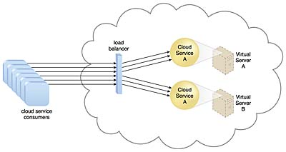

Slide 196
This fundamental architectural model can be applied to any IT resource, with workload distribution commonly carried out in support of distributed virtual servers, cloud storage devices, and cloud services.

Slide 197
In addition to the base load balancer mechanism, and the virtual server and cloud storage device mechanisms to which load balancing can be applied, the following mechanisms can also be part of this cloud architecture:
Audit Monitor – When distributing runtime workloads, the type and geographical location of the IT resources that process the data can determine whether monitoring is necessary to fulfill legal and regulatory requirements.
Cloud Usage Monitor – Various monitors can be involved to carry out runtime workload tracking and data processing.
Hypervisor – Workloads between hypervisors and the virtual servers that they host may require distribution.
Logical Network Perimeter – The logical network perimeter isolates cloud consumer network boundaries in relation to how and where workloads are distributed.
Resource Cluster – Clustered IT resources in active/active mode are commonly used to support workload balancing between different cluster nodes.
Resource Replication – This mechanism can generate new instances of virtualized IT resources in response to runtime workload distribution demands.

Slide 198
Resource Pooling Architecture
A resource pooling architecture is based on the use of one or more resource pools, in which identical IT resources are grouped and maintained by a system that automatically ensures that they remain synchronized.

Slide 199
Physical server pools are composed of networked servers that have been installed with operating systems and other necessary programs and/or applications and are ready for immediate use.
Virtual server pools are usually configured using one of several available templates chosen by the cloud consumer during provisioning. For example, a cloud consumer can set up a pool of mid-tier Windows servers with 4 GB of RAM or a pool of low-tier Ubuntu servers with 2 GB of RAM.

Slide 200
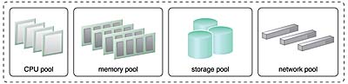

Slide 201
Storage pools, or cloud storage device pools, consist of file-based or block-based storage structures that contain empty and/or filled cloud storage devices.
Network pools (or interconnect pools) are composed of different preconfigured network connectivity devices. For example, a pool of virtual firewall devices or physical network switches can be created for redundant connectivity, load balancing, or link aggregation.
CPU pools are ready to be allocated to virtual servers, and are typically broken down into individual processing cores.
Pools of physical RAM can be used in newly provisioned physical servers or to vertically scale physical servers.
Dedicated pools can be created for each type of IT resource and individual pools can be grouped into a larger pool, in which case each individual pool becomes a sub-pool

Slide 202
Resource pools can become highly complex, with multiple pools created for specific cloud consumers or applications. A hierarchical structure can be established to form parent, sibling, and nested pools in order to facilitate the organization of diverse resource pooling requirements.
Sibling resource pools are usually drawn from physically grouped IT resources, as opposed to IT resources that are spread out over different data centers. Sibling pools are isolated from one another so that each cloud consumer is only provided access to its respective pool.
In the nested pool model, larger pools are divided into smaller pools that individually group the same type of IT resources together. Nested pools can be used to assign resource pools to different departments or groups in the same cloud consumer organization.

Slide 203
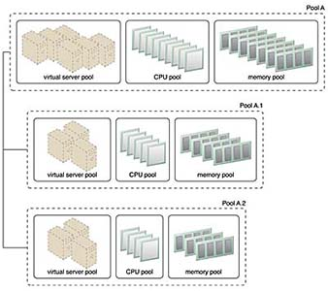

Slide 204
After resources pools have been defined, multiple instances of IT resources from each pool can be created to provide an in-memory pool of “live” IT resources.
In addition to cloud storage devices and virtual servers, which are commonly pooled mechanisms, the following mechanisms can also be part of this cloud architecture:
Audit Monitor – This mechanism monitors resource pool usage to ensure compliance with privacy and regulation requirements, especially when pools contain cloud storage devices or data loaded into memory.
Cloud Usage Monitor – Various cloud usage monitors are involved in the runtime tracking and synchronization that are required by the pooled IT resources and any underlying management systems.
Hypervisor – The hypervisor mechanism is responsible for providing virtual servers with access to resource pools, in addition to hosting the virtual servers and sometimes the resource pools themselves.
Logical Network Perimeter – The logical network perimeter is used to logically organize and isolate resource pools.
Pay-Per-Use Monitor – The pay-per-use monitor collects usage and billing information on how individual cloud consumers are allocated and use IT resources from various pools.
Remote Administration System – This mechanism is commonly used to interface with backend systems and programs in order to provide resource pool administration features via a front-end portal.
Resource Management System – The resource management system mechanism supplies cloud consumers with the tools and permission management options for administering resource pools.
Resource Replication – This mechanism is used to generate new instances of IT resources for resource pools.

Slide 205
Dynamic Scalability Architecture
The dynamic scalability architecture is an architectural model based on a system of predefined scaling conditions that trigger the dynamic allocation of IT resources from resource pools. Dynamic allocation enables variable utilization as dictated by usage demand fluctuations, since unnecessary IT resources are efficiently reclaimed without requiring manual interaction.
The automated scaling listener is configured with workload thresholds that dictate when new IT resources need to be added to the workload processing. This mechanism can be provided with logic that determines how many additional IT resources can be dynamically provided, based on the terms of a given cloud consumer’s provisioning contract.

Slide 206
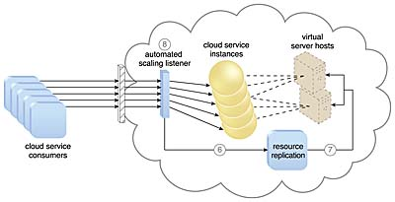

Slide 207
The following types of dynamic scaling are commonly used:
Dynamic Horizontal Scaling – IT resource instances are scaled out and in to handle fluctuating workloads. The automatic scaling listener monitors requests and signals resource replication to initiate IT resource duplication, as per requirements and permissions.
Dynamic Vertical Scaling – IT resource instances are scaled up and down when there is a need to adjust the processing capacity of a single IT resource. For example, a virtual server that is being overloaded can have its memory dynamically increased or it may have a processing core added.
Dynamic Relocation – The IT resource is relocated to a host with more capacity. For example, a database may need to be moved from a tape-based SAN storage device with 4 GB per second I/O capacity to another disk-based SAN storage device with 8 GB per second I/O capacity.

Slide 208
The dynamic scalability architecture can be applied to a range of IT resources, including virtual servers and cloud storage devices. Besides the core automated scaling listener and resource replication mechanisms, the following mechanisms can also be used in this form of cloud architecture:
Cloud Usage Monitor – Specialized cloud usage monitors can track runtime usage in response to dynamic fluctuations caused by this architecture.
Hypervisor – The hypervisor is invoked by a dynamic scalability system to create or remove virtual server instances, or to be scaled itself.
Pay-Per-Use Monitor – The pay-per-use monitor is engaged to collect usage cost information in response to the scaling of IT resources.

Slide 209
Elastic Resource Capacity Architecture
The elastic resource capacity architecture is primarily related to the dynamic provisioning of virtual servers, using a system that allocates and reclaims CPUs and RAM in immediate response to the fluctuating processing requirements of hosted IT resources

Slide 210
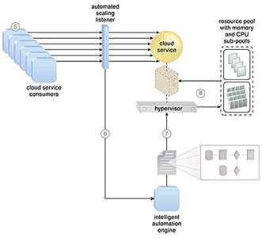

Slide 211
Resource pools are used by scaling technology that interacts with the hypervisor and/or VIM to retrieve and return CPU and RAM resources at runtime. The runtime processing of the virtual server is monitored so that additional processing power can be leveraged from the resource pool via dynamic allocation, before capacity thresholds are met. The virtual server and its hosted applications and IT resources are vertically scaled in response.
This type of cloud architecture can be designed so that the intelligent automation engine script sends its scaling request via the VIM instead of to the hypervisor directly. Virtual servers that participate in elastic resource allocation systems may require rebooting in order for the dynamic resource allocation to take effect.
Some additional mechanisms that can be included in this cloud architecture are the following:
Cloud Usage Monitor – Specialized cloud usage monitors collect resource usage information on IT resources before, during, and after scaling, to help define the future processing capacity thresholds of the virtual servers.
Pay-Per-Use Monitor – The pay-per-use monitor is responsible for collecting resource usage cost information as it fluctuates with the elastic provisioning.
Resource Replication – Resource replication is used by this architectural model to generate new instances of the scaled IT resources.

Slide 212
Service Load Balancing Architecture
The service load balancing architecture can be considered a specialized variation of the workload distribution architecture that is geared specifically for scaling cloud service implementations. Redundant deployments of cloud services are created, with a load balancing system added to dynamically distribute workloads.
The duplicate cloud service implementations are organized into a resource pool, while the load balancer is positioned as either an external or built-in component to allow the host servers to balance the workloads themselves.
Depending on the anticipated workload and processing capacity of host server environments, multiple instances of each cloud service implementation can be generated as part of a resource pool that responds to fluctuating request volumes more efficiently.

Slide 213
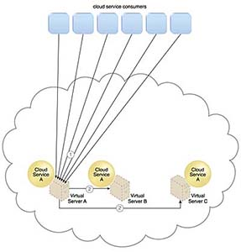

Slide 214
The service load balancing architecture can involve the following mechanisms in addition to the load balancer:
Cloud Usage Monitor – Cloud usage monitors may be involved with monitoring cloud service instances and their respective IT resource consumption levels, as well as various runtime monitoring and usage data collection tasks.
Resource Cluster – Active-active cluster groups are incorporated in this architecture to help balance workloads across different members of the cluster.
Resource Replication – The resource replication mechanism is utilized to generate cloud service implementations in support of load balancing requirements.

Slide 215
Cloud Bursting Architecture
The cloud bursting architecture establishes a form of dynamic scaling that scales or “bursts out” on-premise IT resources into a cloud whenever predefined capacity thresholds have been reached. The corresponding cloud-based IT resources are redundantly pre-deployed but remain inactive until cloud bursting occurs. After they are no longer required, the cloud-based IT resources are released and the architecture “bursts in” back to the on-premise environment.
Cloud bursting is a flexible scaling architecture that provides cloud consumers with the option of using cloud-based IT resources only to meet higher usage demands. The foundation of this architectural model is based on the automated scaling listener and resource replication mechanisms.
The automated scaling listener determines when to redirect requests to cloud-based IT resources, and resource replication is used to maintain synchronicity between on-premise and cloud-based IT resources in relation to state information

Slide 216
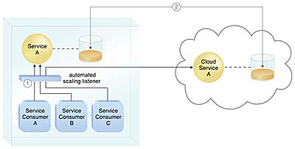

Slide 217
Elastic Disk Provisioning Architecture
Cloud consumers are commonly charged for cloud-based storage space based on fixed-disk storage allocation, meaning the charges are predetermined by disk capacity and not aligned with actual data storage consumption.
The cloud consumer is billed for using 450 GB of storage space after installing the operating system, even though the operating system only requires 15 GB of storage space.

Slide 218
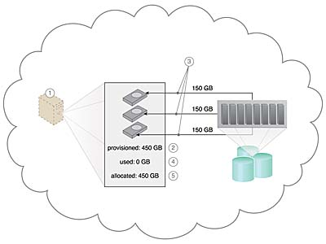

Slide 219
The following mechanisms can be included in this architecture in addition to the cloud storage device, virtual server, hypervisor, and pay-per-use monitor:
Cloud Usage Monitor – Specialized cloud usage monitors can be used to track and log storage usage fluctuations.
Resource Replication – Resource replication is part of an elastic disk provisioning system when conversion of dynamic thin-disk storage into static thick-disk storage is required.

Slide 220
Redundant Storage Architecture
Cloud storage devices are occasionally subject to failure and disruptions that are caused by network connectivity issues, controller or general hardware failure, or security breaches.
A compromised cloud storage device’s reliability can have a ripple effect and cause impact failure across all of the services, applications, and infrastructure components in the cloud that are reliant on its availability.

Slide 221
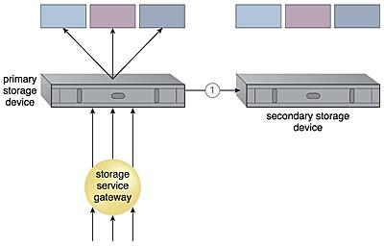
The redundant storage architecture introduces a secondary duplicate cloud storage device as part of a failover system that synchronizes its data with the data in the primary cloud storage device. A storage service gateway diverts cloud consumer requests to the secondary device whenever the primary device fails.

Slide 222
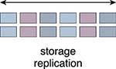
Storage replication is a variation of the resource replication mechanisms used to synchronously or asynchronously replicate data from a primary storage device to a secondary storage device. It can be used to replicate partial and entire LUNs.
Cloud providers may locate secondary cloud storage devices in a different geographical region than the primary cloud storage device, usually for economic reasons. However, this can introduce legal concerns for some types of data. The location of the secondary cloud storage devices can dictate the protocol and method used for synchronization, as some replication transport protocols have distance restrictions.
Some cloud providers use storage devices with dual array and storage controllers to improve device redundancy, and place secondary storage devices in a different physical location for cloud balancing and disaster recovery purposes. In this case, cloud providers may need to lease a network connection via a third-party cloud provider in order to establish the replication between the two devices.

Slide 223
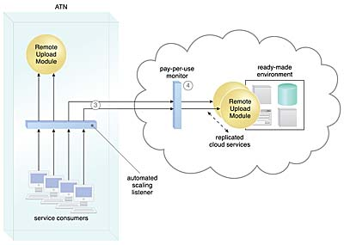
Case Study Example
An in-house solution that ATN did not migrate to the cloud is the Remote Upload Module, a program that is used by their clients to upload accounting and legal documents to a central archive on a daily basis. Usage peaks occur without warning, since the quantity of documents received on a day-by-day basis is unpredictable.
The Remote Upload Module currently rejects upload attempts when it is operating at capacity, which is problematic for users that need to archive certain documents before the end of a business day or prior to a deadline.
ATN decides to take advantage of its cloud-based environment by creating a cloud-bursting architecture around the on-premise Remote Upload Module service implementation. This enables it to burst out into the cloud whenever on-premise processing thresholds are exceeded.

Slide 224
Cloud Computing Reference Architecture (CCRA)
IBM constantly refines the Cloud Computing Reference Architecture (CCRA) based on the changing regulatory and compliance needs (based on the solid security and privacy frameworks). The CCRA is intended to be used as a blueprint for architecting cloud implementations, driven by functional and non-functional requirements of the respective cloud implementation.
The CCRA defines the basic building blocks—architectural elements and their relationships—which make up the cloud. IBM Federal Cloud Computing Reference Architecture considers key cloud requirements like FedRAMP and Sec-508 augmented by PaaS innovations. IBM products like Bluemix enable rapid application development in the cloud via DevOps. This improves the time to capability and reduces the overall IT costs associated with private, public and hybrid cloud models.

Slide 225
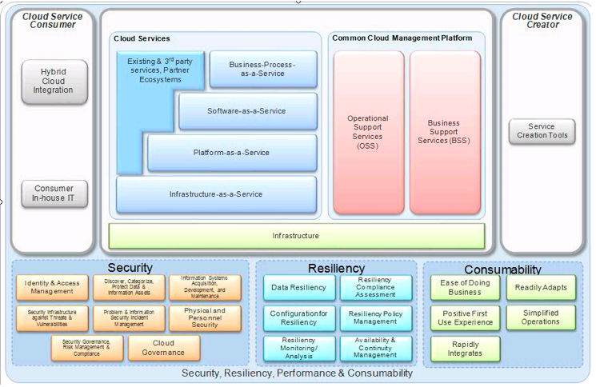

Slide 226
Benefits of CCRA
Using a reference architecture allows the team to deliver a solution quicker, and with fewer errors. Re-using an architecture provides advantages such as quicker delivery of a solution, reduced design effort, reduced costs, and increased quality.

Slide 227
Migration Risks and Mitigation
1. Intricate Architecture
Cloud migrations approaches often fail due to the complex architecture. Data-rich applications are also dependent on multiple elements and environments.
Cloud Migration Strategy: Manage only one complex architecture that is currently existing on-premise. Design architecture in such a way that it consumes data stored in the enterprise’s IT environment.
2. Multiple Dependencies
Multiple dependencies with on-premises environments create problems during lift and shift.
Cloud Mitigation Strategy: The best bet is to consider solutions that test before migration. They can identify and remediate the differences in environments. Seek the services of a cloud services provider who offers services that are relevant to your needs.

Slide 228
3. Data Gravity
Data Gravity becomes difficult to test if an application and its data are not working as it should in the cloud. Most replication-based migration tools require data to be moved before the apps due to improper sequencing problems.
Cloud Migration Strategy: Use live cloud migration approaches and tools that stream the whole instance. Live migration eliminates the need for complex system synchronization and avoids consistency issues.
4. Management And Control Of Data Streams Within Heterogeneous Environments
Databases that require a consistent view create unpredictable issues. Also, transactional production servers that continuously generate data are hard to manage. After data migration, the system must track and synchronize new changes to the production application. Furthermore, there may be security concerns with storing production data in the public cloud. It leads to a lack of control over multiple data repositories across a hybrid IT landscape.

Slide 229
5. Cloud Gravity: IT teams require workload mobility for effective data and workload migration. They must ensure these factors do not affect the business or introduce hidden costs.
Cloud Migration Strategy: In the case of data-rich enterprise applications, evaluate migration solutions for speed and simplicity. Enable portability and interoperability of stateless applications in a multi-cloud strategy, using containers.
6. Latency
Applications can face latency issues when using cloud applications over the Internet.
Cloud Migration Strategy: Use optimization services from a cloud service provider to help tide over latency issues.
7. Architectural difference
It’s common to require modifications for your application design and architecture. But they may not be conducive for distributed cloud environments.
Cloud Migration Strategy: Implement a piece-by-piece evaluation and move only pertinent features.
Choosing a cloud service provider may seem like a tight-rope walk in the decision-making stage. Study your desired architecture thoroughly and choose a cloud resource that works for you. Does it scale for your enterprise, help manage fluctuations, and support the migration of critical applications? It’s essential to accomplish this without adding complexity or compromising data.

Slide 230
Assignment 6
Describe Workload Distribution Architecture
Describe Resource Pooling Architecture
Describe Dynamic Scalability Architecture
Describe Elastic Resource Capacity Architecture
Describe Service Load Balancing Architecture
Describe Cloud Bursting Architecture
Describe Elastic Disk Provisioning Architecture
Describe Redundant Storage Architecture.
Describe Cloud Computing Reference Architecture (CCRA)
Submission link: https://forms.gle/QEge4junT8wYZ5hQ7

Slide 231
Presentation
Case study on Cloud Architectures
Case study on Cloud Computing Reference Architecture (CCRA)
Submission link: https://forms.gle/mj8Q82t1XWPTFXyc9

